Slide 1
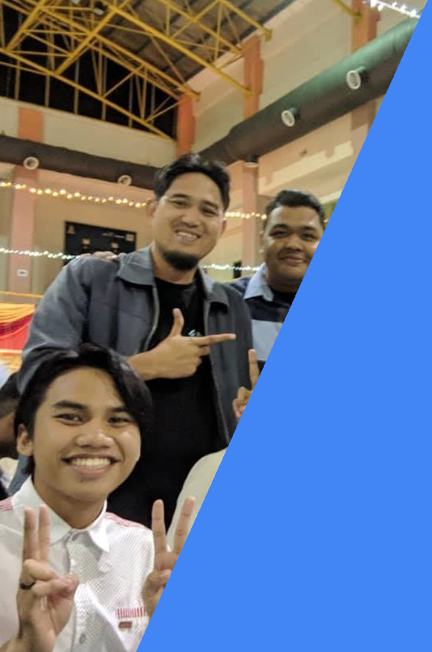


T01 FLUTTER PASANG & TETAPAN
Youtube channel
bit.ly/kerulflutter

Slide 2

Github.com/khirulnizam/makanapps wasap.my/60129034614
Youtube channel
bit.ly/kerulflutter

Slide 3
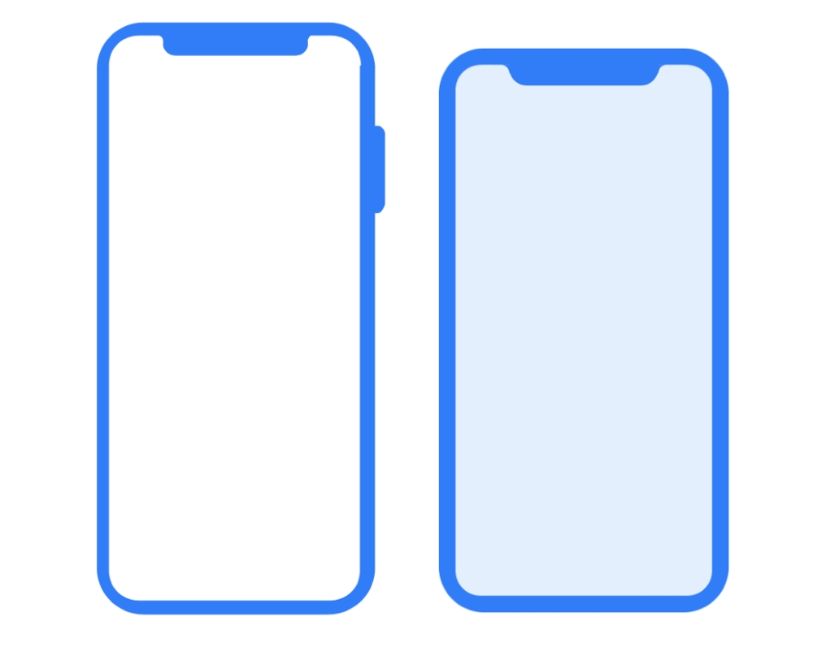


Flutter vs Ionic
Youtube channel
bit.ly/kerulflutter

Slide 4


Slide 5
COURSE OVERVIEW

Slide 6
DAY 1: Introduction to Flutter Framework
DAY 1: Start A Project, Generating Pages & Navigating to it, Run A Project Dart
DAY 1: Flutter widgets: Image & Input Form & Button
DAY 2: Send parameter to another screen Array & ListTile

Slide 7
DAY 2: Google Firestore -creating serverless database Flutter & Firebase CRUD Overview
DAY 2: Retrieving records from Firestore Displaying Snapshot
DAY 2: Insert form Push record to Firestore
DAY 3: Update form Push updated record to Firestore Delete Record

Slide 8
OVERVIEW
TO FLUTTER FRAMEWORK

Slide 9

What is Flutter?
Flutter is Google’s UI toolkit for building beautiful, natively compiled applications for mobile, web, and desktop from a single codebase.

Slide 10
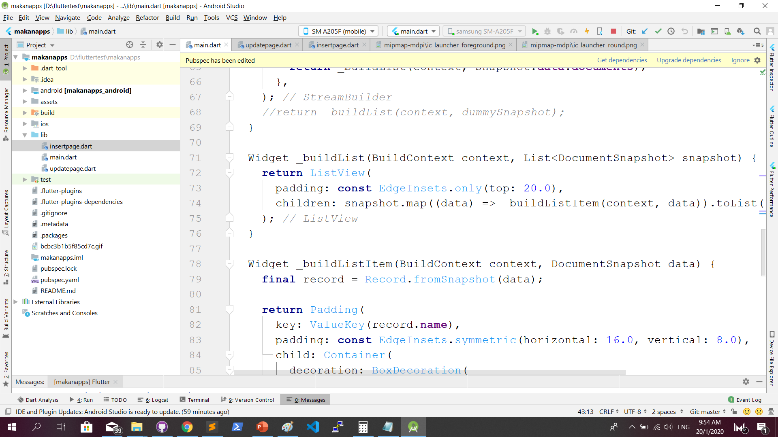
Flutter SDK http://fstm.kuis.edu.my/blog/hello-flutter/

Slide 11
IOS & Android Software Development
In a nutshell

Slide 12
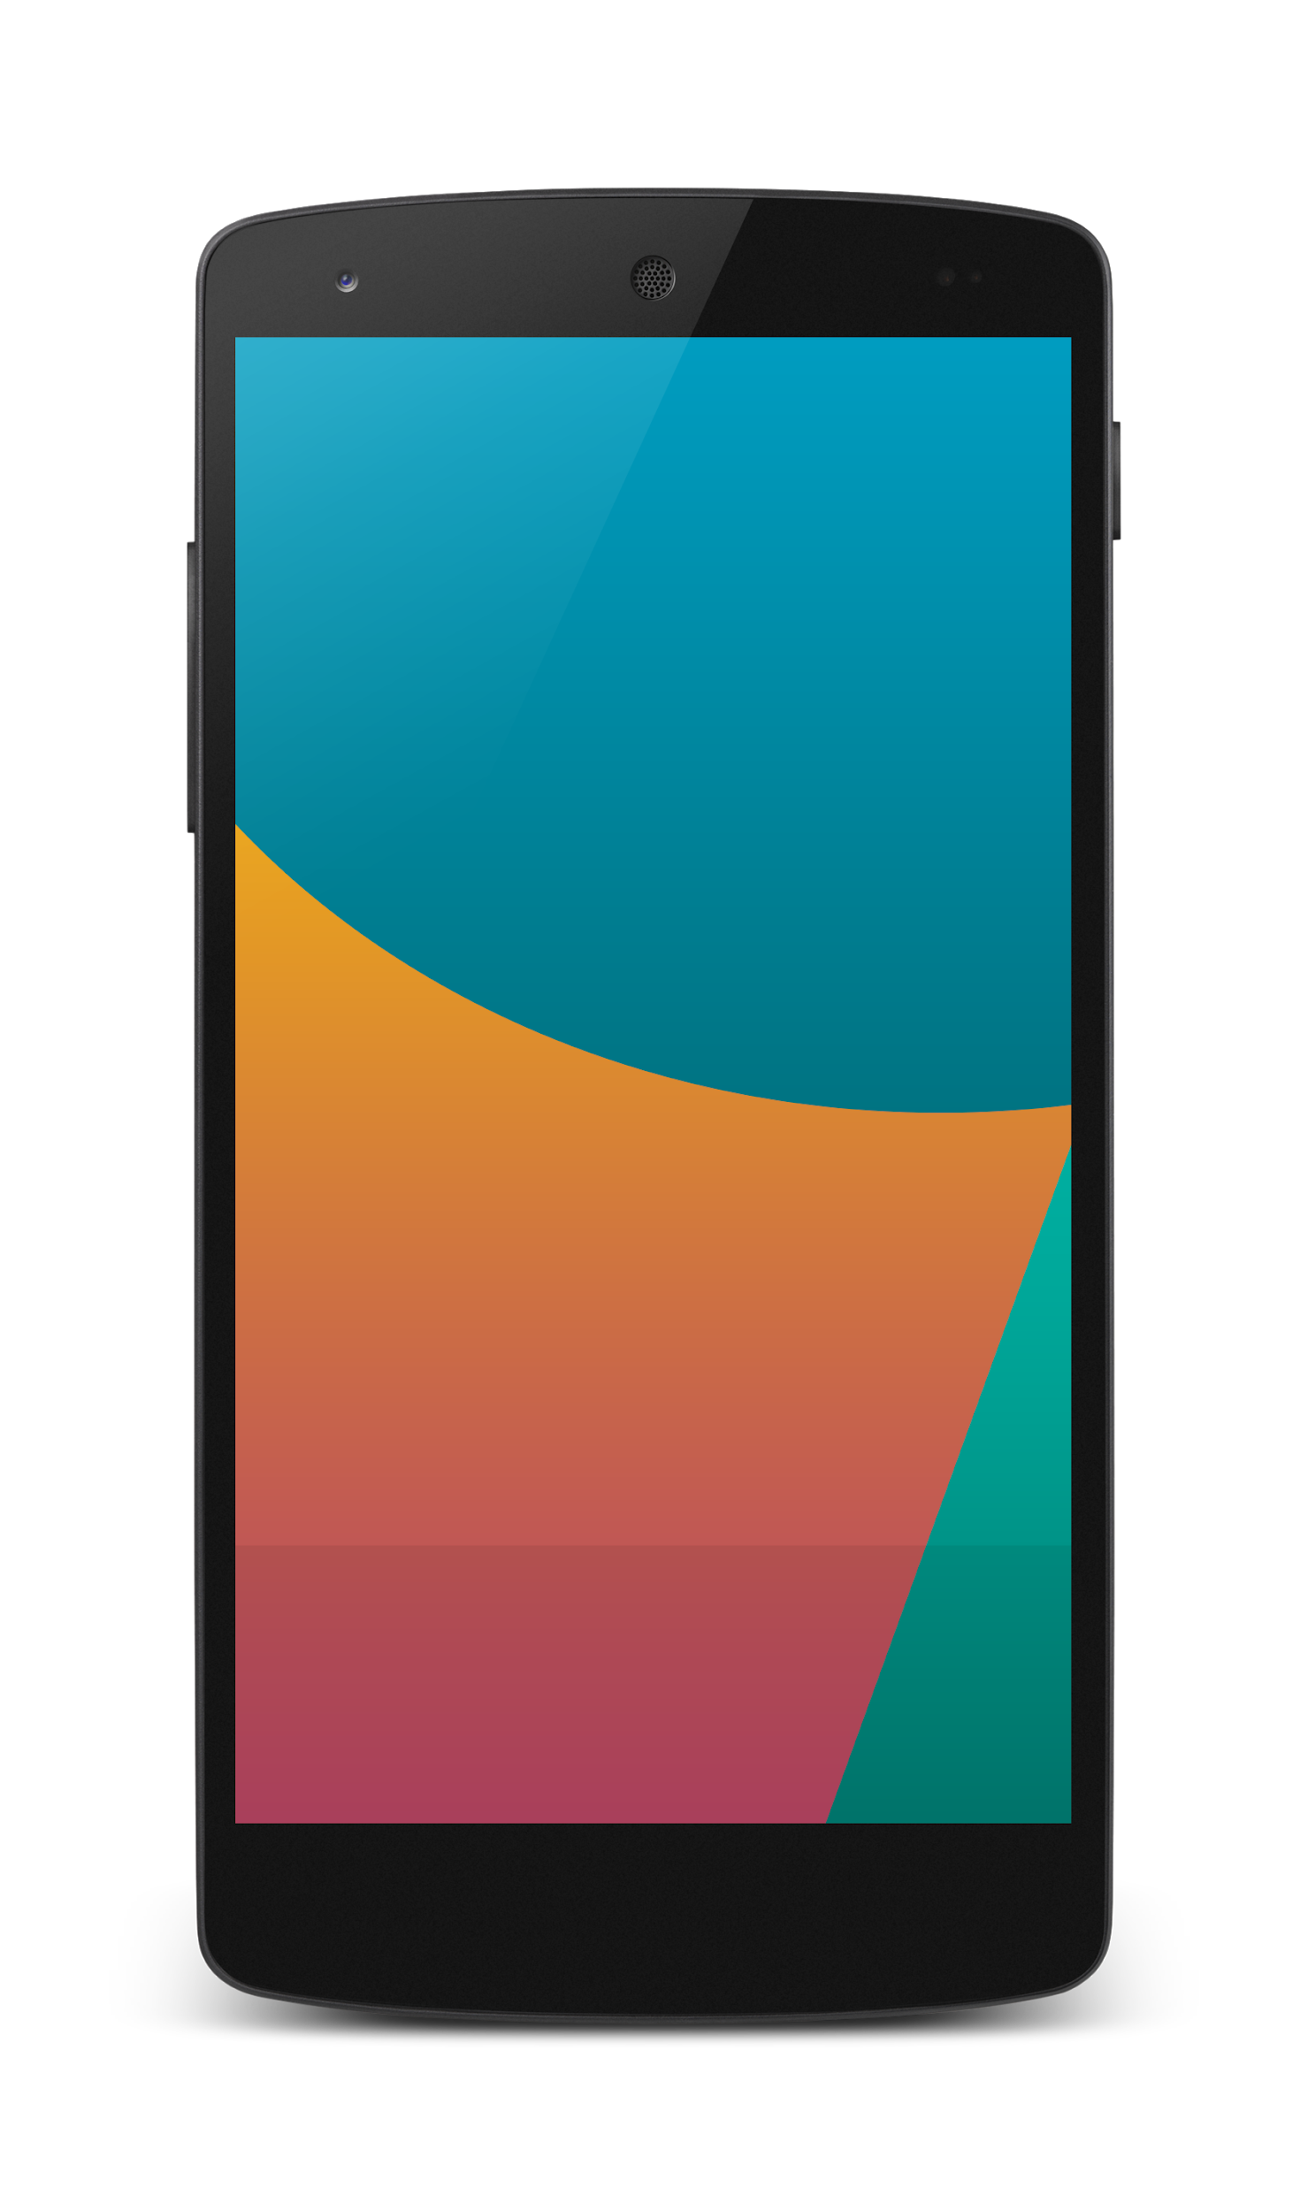


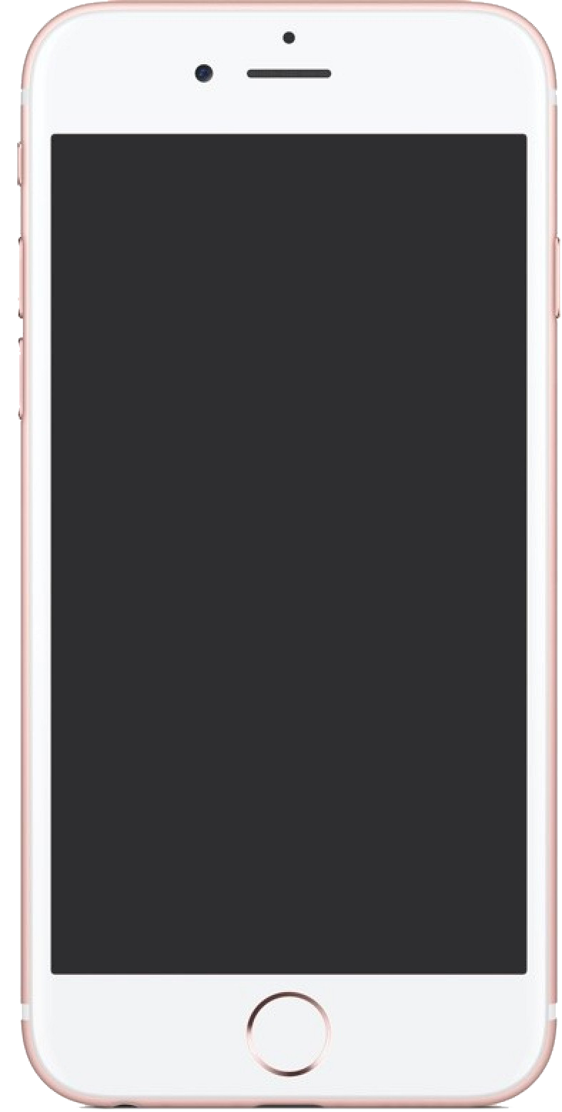

Android Studio
(Java & Kotlin)
Android Device
2 X WORK
XCode (Swift & Objective C)
iPhone/iPad

Slide 13
1 x WORK
Compile with Android SDK
Android Device
Flutter multiplatform
Xcode Project
iPhone/iPad

Slide 14
What do you need?

Slide 15
What do you need?
To run install Flutter:
Flutter SDK
Flutter Doctor
Android SDK (or Xcode- can be done later)
To develop:
Android Studio OR
VSCode
Emulator
Or actual device

Slide 16
Now, let’s install the tools

Slide 17
Softwares needed
Download and install Android Studio & SDK (from https://developer.android.com/studio)
Add Flutter/Dart plugins
Download Flutter SDK (from https://flutter.dev/docs/get-started/install/windows)
Run flutter doctor
Tutorial http://fstm.kuis.edu.my/blog/hello-flutter/

Slide 18
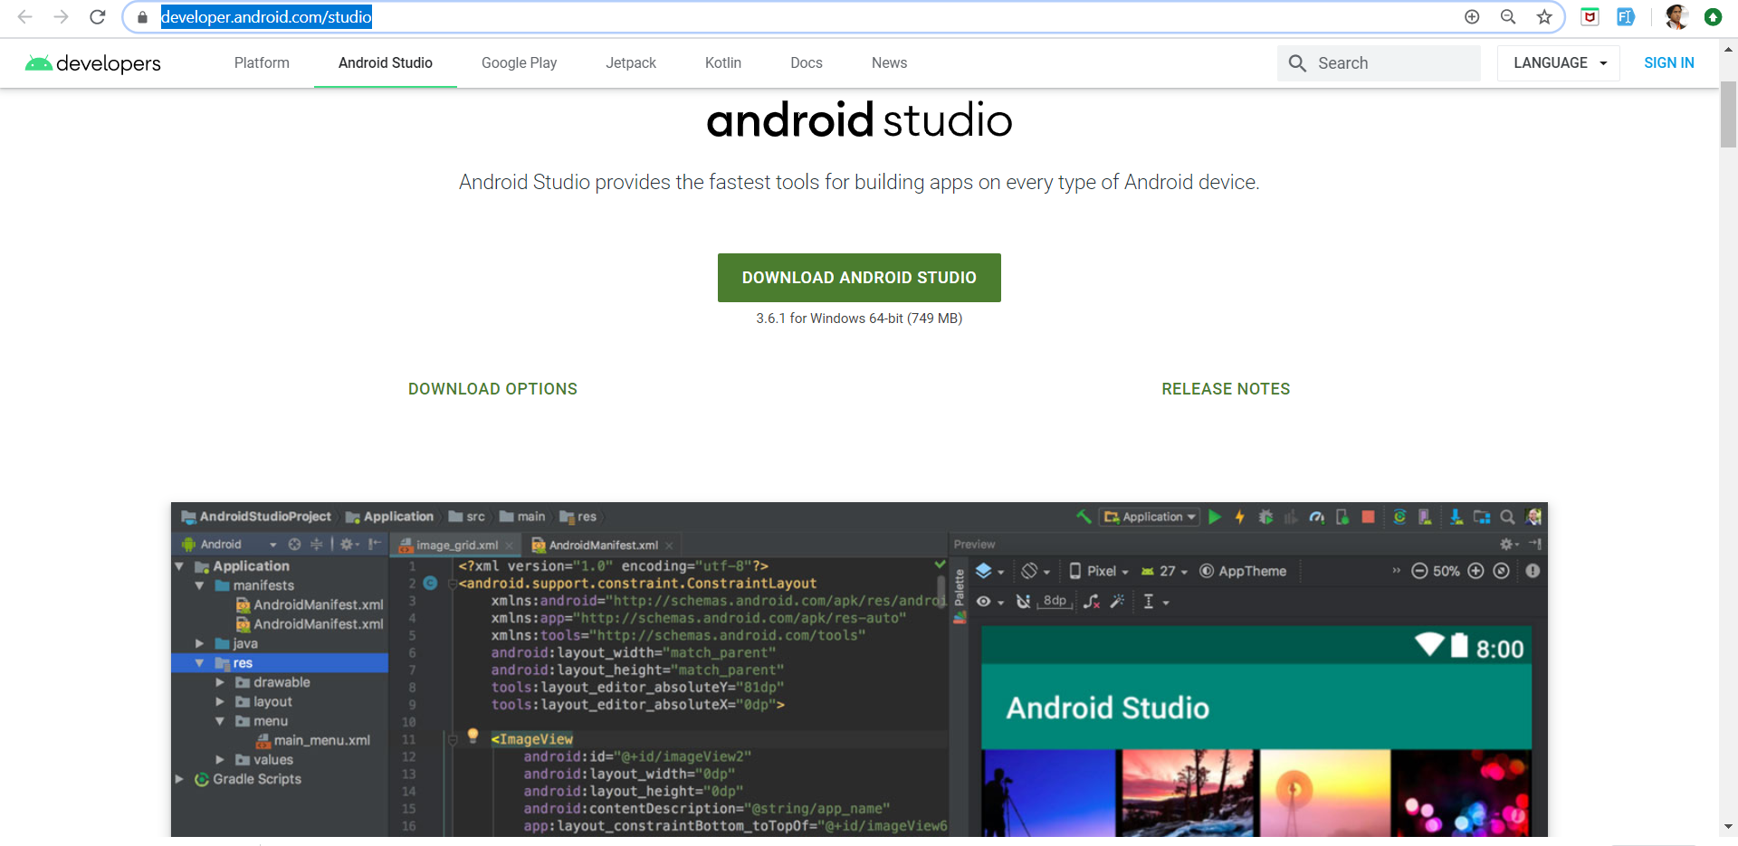
Download and install Android Studio & SDK (from https://developer.android.com/studio)

Slide 19
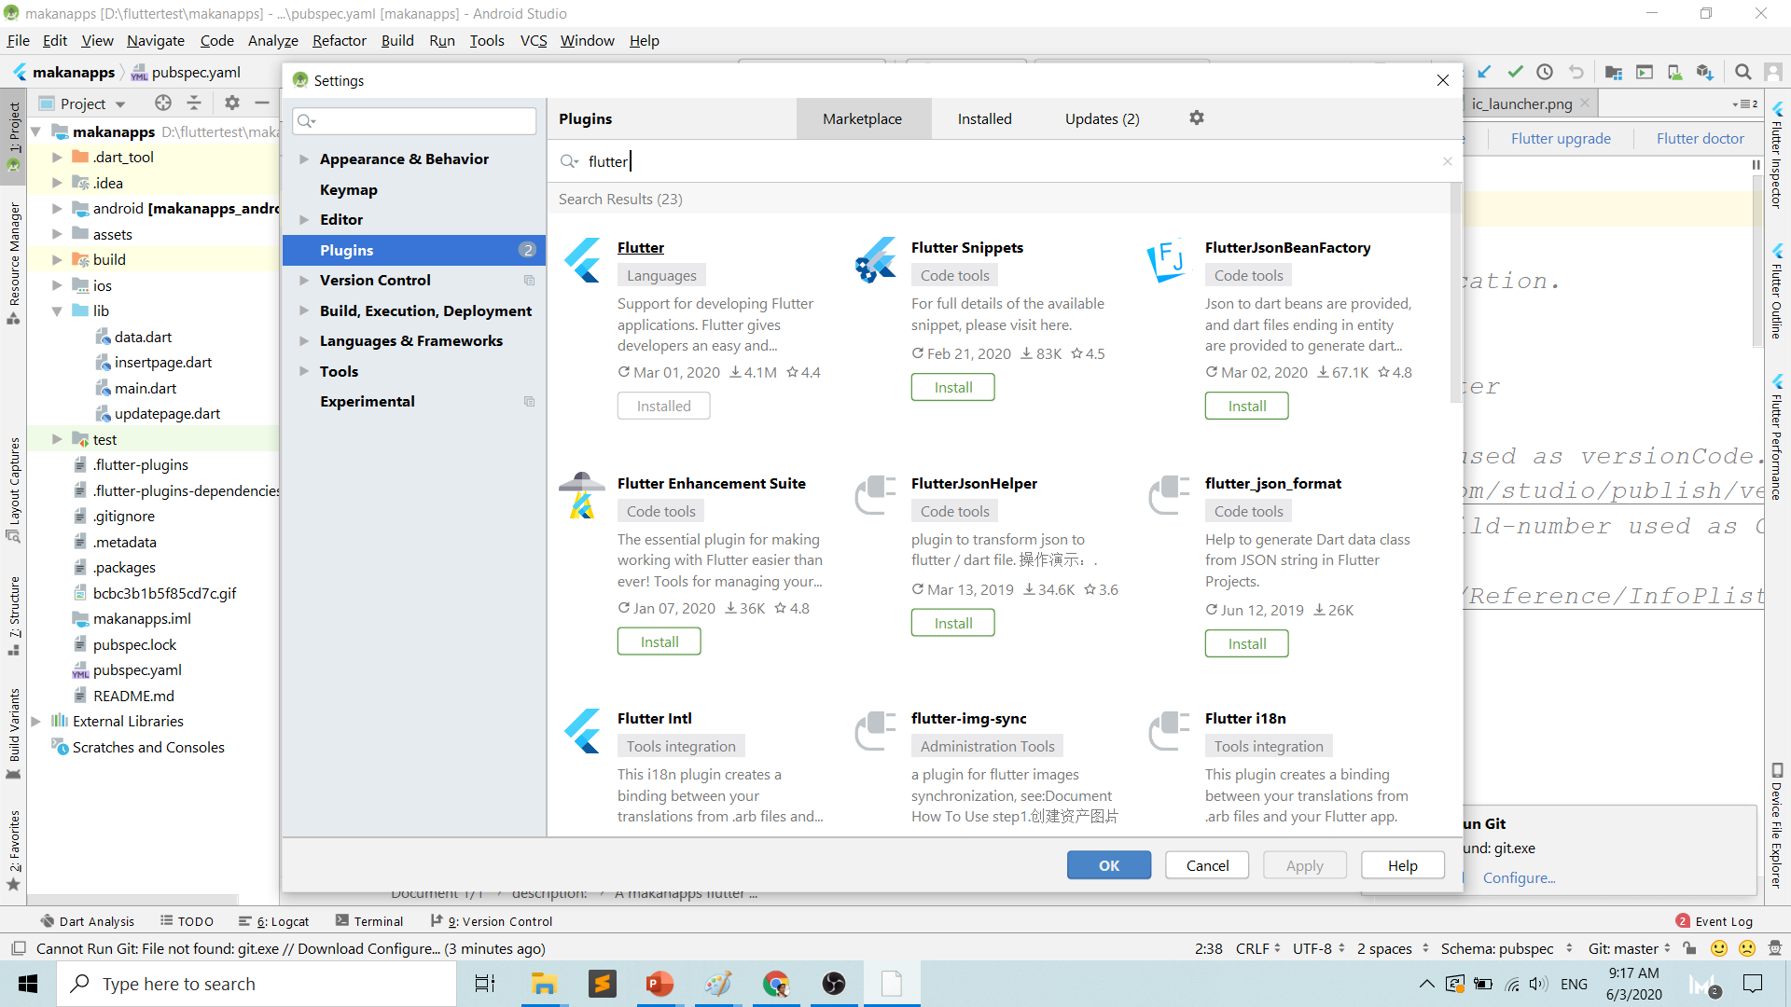
Flutter plugins for Android Studio

Slide 20
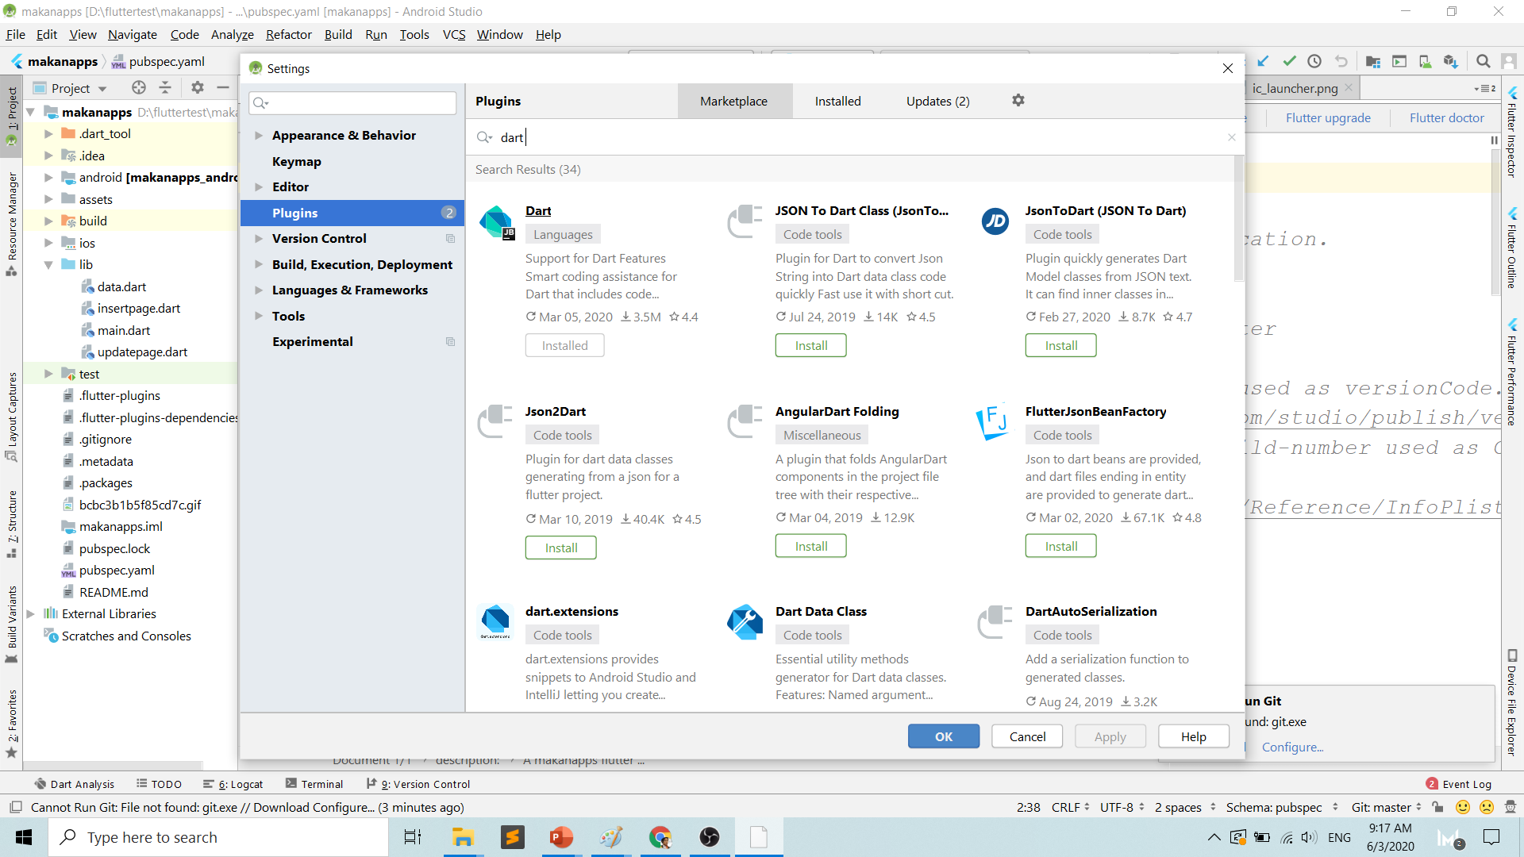
Dart plugins for Android Studio

Slide 21
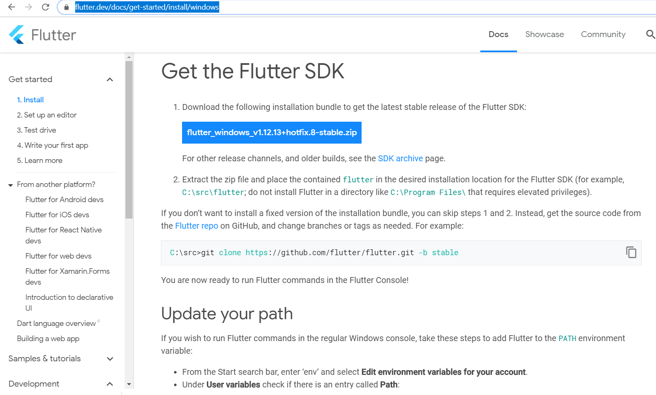
Download Flutter SDK (from https://flutter.dev/docs/get-started/install/windows)

Slide 22
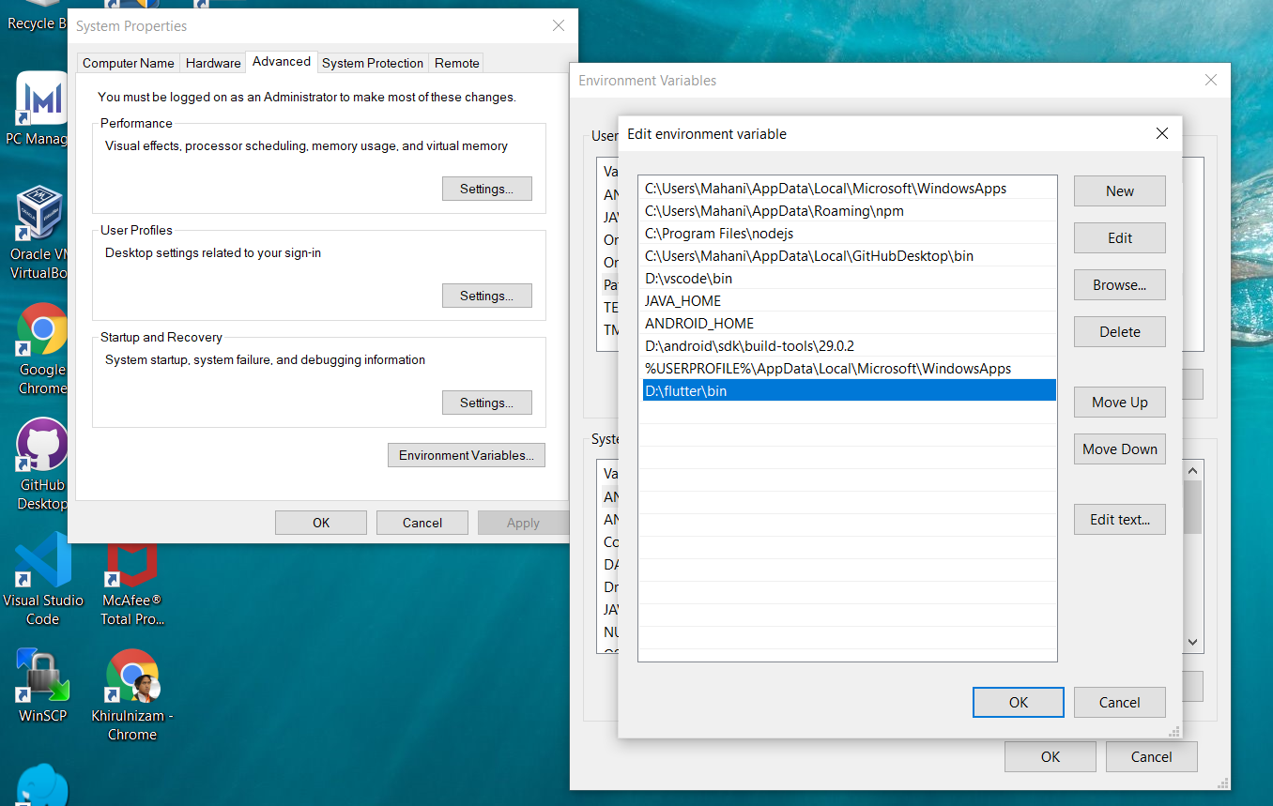
Add path to flutter/bin in environment variable

Slide 23
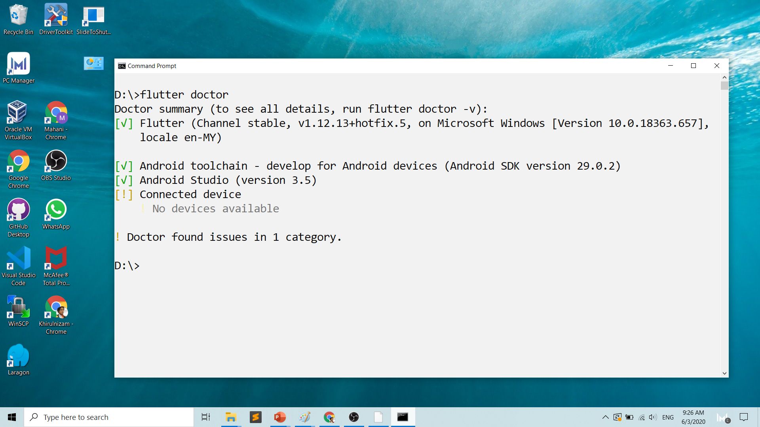
Run flutter doctor

Slide 24
HelloWorld Flutter

Slide 25
New Flutter project

Slide 26
T02 Pengedit Kod VSCode
Youtube channel
bit.ly/kerulflutter

Slide 28
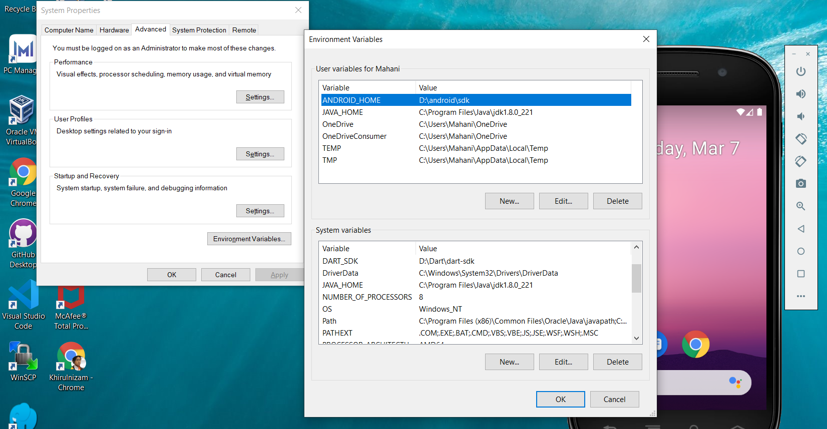
ANDROID_HOME path

Slide 29
What do you need?
To run install Flutter:
Flutter SDK
Flutter Doctor
Android SDK
To develop:
Android Studio OR
VSCode
Emulator
Or actual device

Slide 30
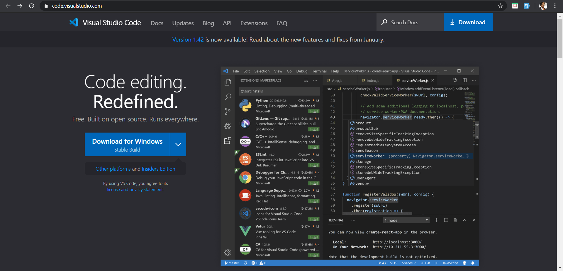
Download VSCode from code.visualstudio.com

Slide 31
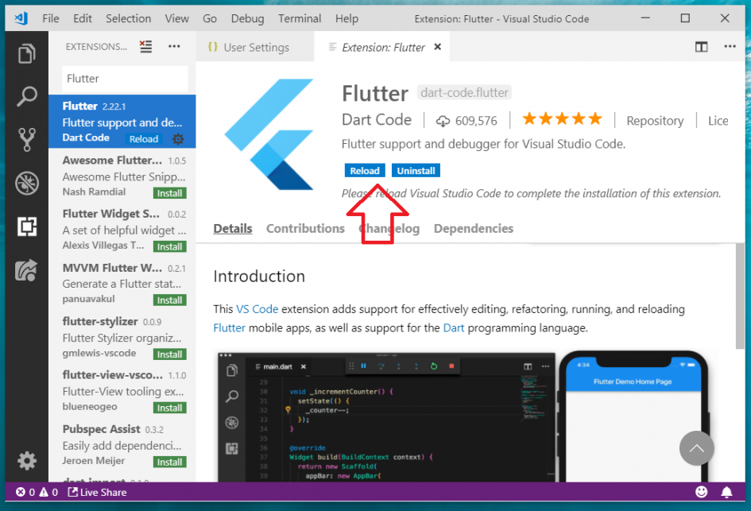
Flutter in Visual Studio Code http://fstm.kuis.edu.my/blog/flutter-vscode/
Add plugins
Flutter
Dart

Slide 32
Create Flutter project
Create new Flutter project (Ctrl+Shift+P)
Run F5

Slide 33
T03 AVD Emulator, panggil dari CLI
Youtube channel
bit.ly/kerulflutter

Slide 34
What do you need?
To run install Flutter:
Flutter SDK
Flutter Doctor
Android SDK
To develop:
Android Studio OR
VSCode
Emulator
Or actual device

Slide 35
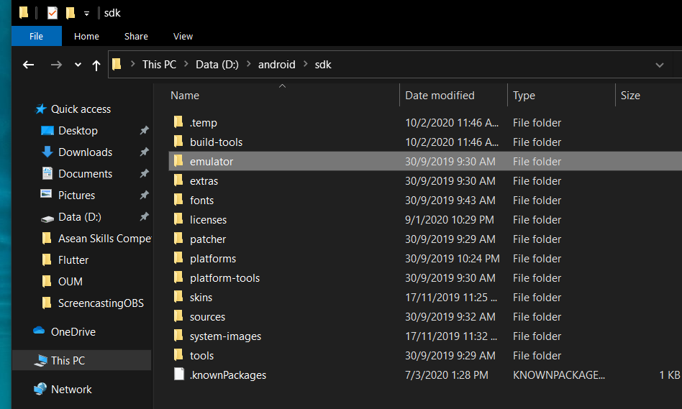
Android/sdk/emulator location

Slide 36
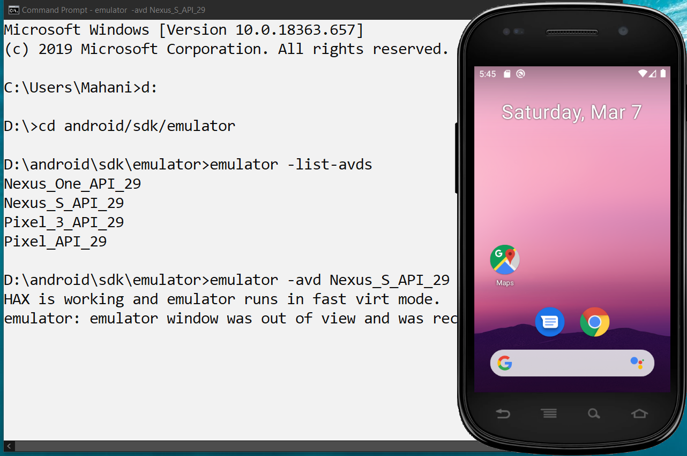
Emulator –avd NAME_OF_AVD
Inside folder android/sdk/emulator
emulator –list-avds
emulator –avd NAME_AVD

Slide 37

T04 Asset & Image, Text & TextField
Youtube channel
bit.ly/kerulflutter

Slide 39
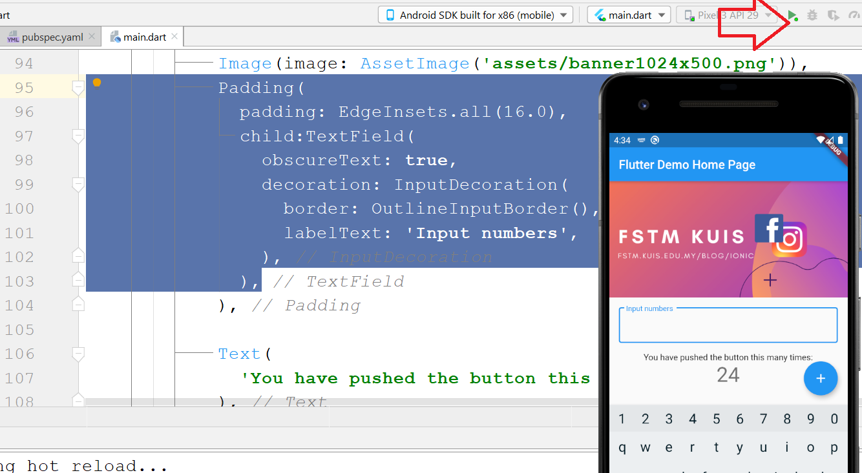
Test app on actual device / emulator: main

Slide 40
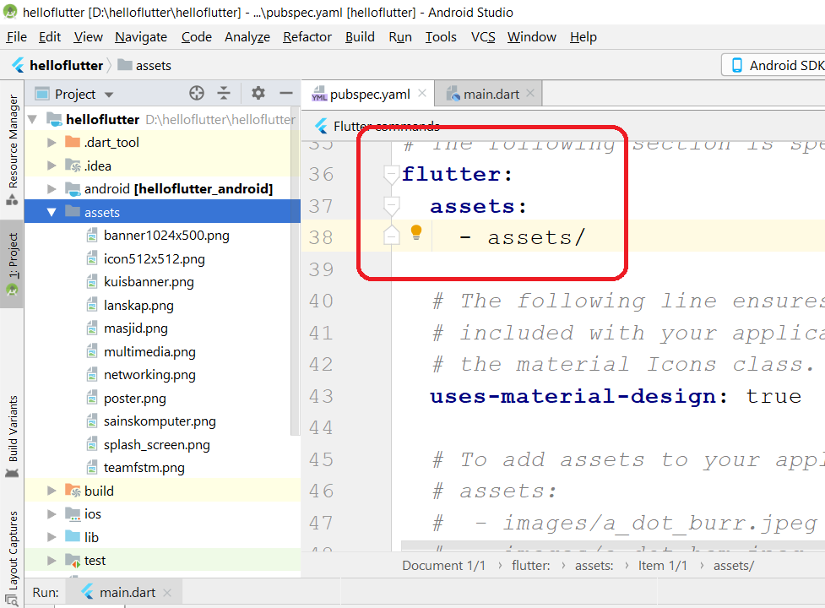
Preparing Image Assets: pubspec.yaml

Slide 41
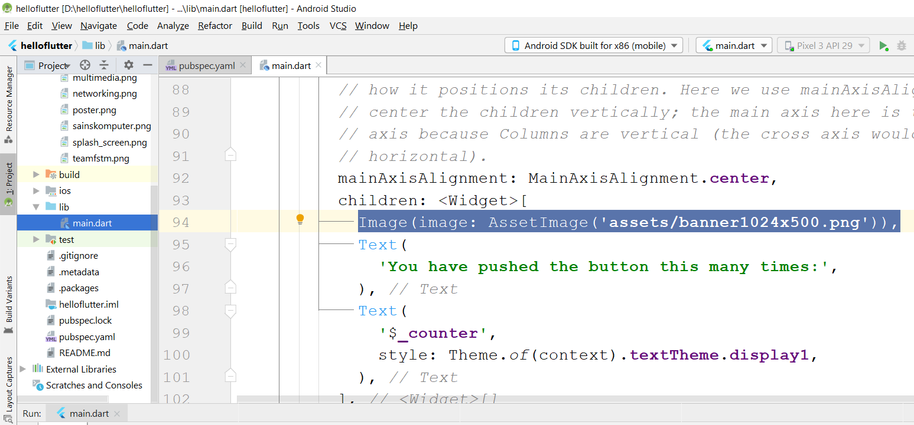
Lib : main.dart

Slide 42
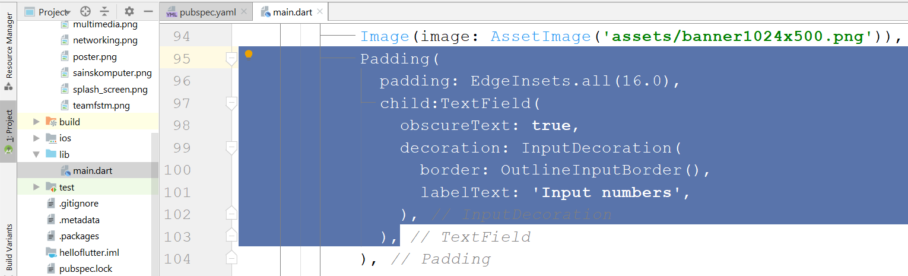
Add Padding & TextField : main.dart

Slide 43
Test app on actual device / emulator: main

Slide 44
T05 Dart language var & string TextField
Youtube channel
bit.ly/kerulflutter

Slide 46
Before we start coding, some basic stuff...

Slide 47

DART? Is a client-optimized language for fast apps on any platform. Made & backed by Google

Slide 48
Dart Syntax simplified…
What is a variable?
double pi = 3.14;
String name=‘enKerul’;
A variable, by definition, is “a named space in the memory” that stores values
In other words, it acts as a container for values in a program
Data types:
Var
can be numbers or words
String
“this is string ” + “ concat”
Objects
{name: “Mickey”}
Array
can be a collection of Var, Strings or Objects

Slide 49
Dart Syntax simplified…
String manipulation?
String stringpi = “3.14”;
double pi = 3.14;
print('pi is $pi');
print('tau is ${2 * pi}');
To convert String to number var
numpi = int.parse(stringpi);
num=double.parse(stringpi);

Slide 50
Dart Syntax simplified…
Array? Array
can be a collection of Var, Strings or Objects
// A list literal.
var lostNumbers = [4, 8, 15, 16, 23, 42];
print(lostNumbers.last);
Output: 42
// A map literal.
// Asociative array
var nobleGases = {
'He': 'Helium',
'Ne': 'Neon',
'Ar': 'Argon',
};
print(nobleGases['Ne’]);
Output: Neon

Slide 51
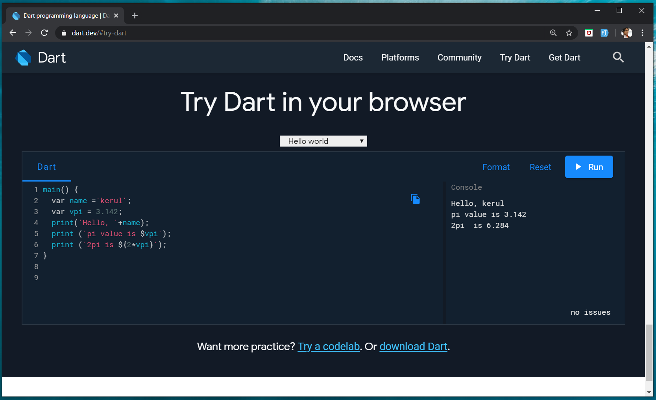
Try Dart at dart.dev

Slide 52
So how to implement in Flutter?...

Slide 53
Test app on actual device / emulator: main

Slide 54

Youtube tutorials
bit.ly/kerulflutter

Slide 55
T06 Button & Page Navigation
Youtube tutorials
bit.ly/kerulflutter

Slide 57
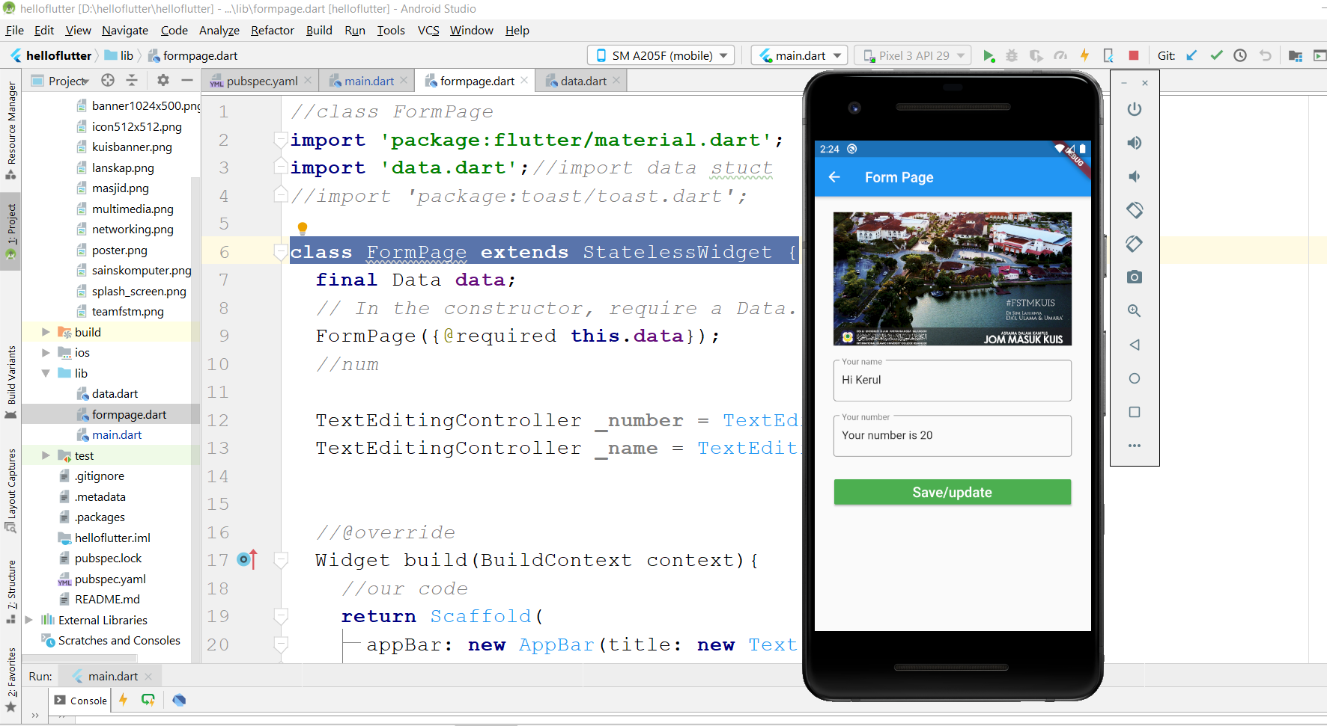
Test app on actual device / emulator: formpage

Slide 58
Code at github
github.com/khirulnizam/helloflutter/blob/master/helloflutter/lib/formpage.dart

Slide 59
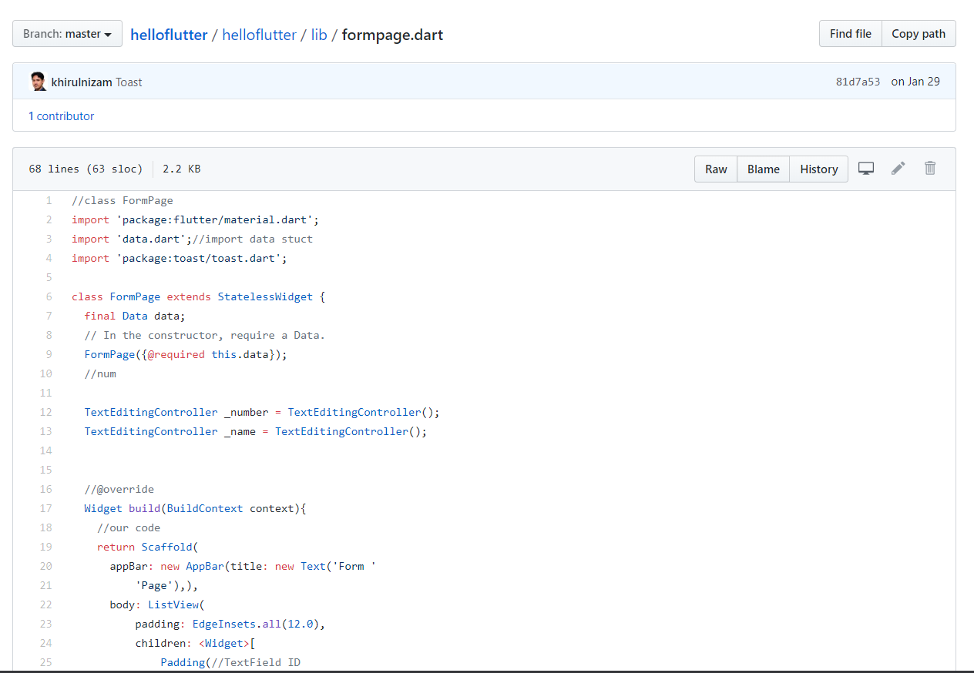
Code for formpage.dart at github.com/khirulnizam/helloflutter

Slide 60
Navigator
Page1
Page2
Navigator.of(context).pushNamed('/page2');

Slide 61
Exercise : Link to new page
Add new file in lib folder, and import in main.dart
lib/formpage.dart

Slide 62
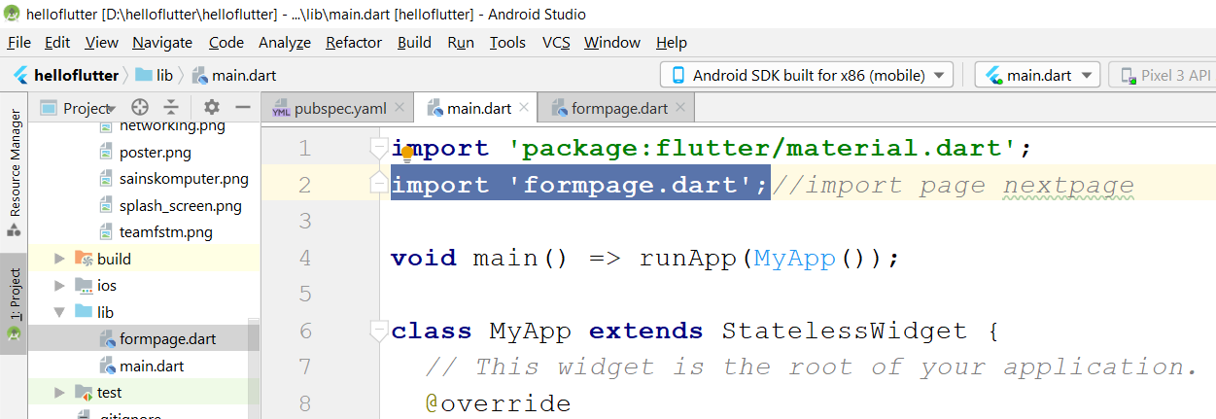
Import new page file

Slide 63
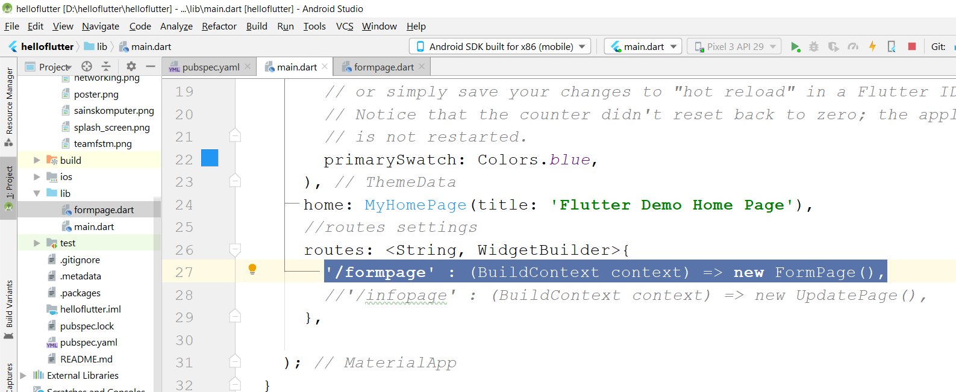
Register the routing name of the new page

Slide 64
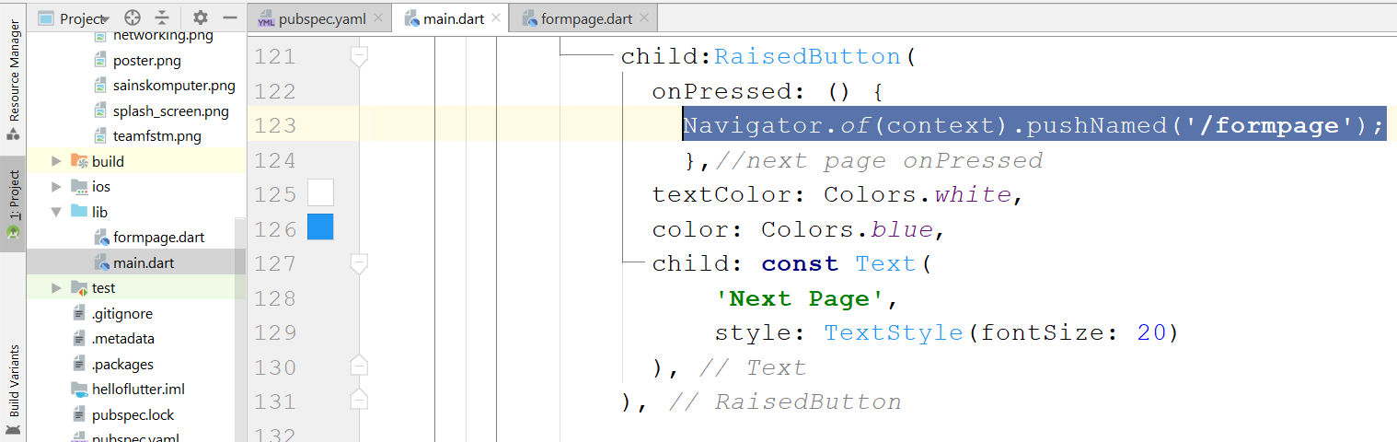
Call the new page from a button

Slide 65
In the next page
lib/formupdate.dart

Slide 66
T07 Navigation with Parameters
Youtube tutorials
bit.ly/kerulflutter

Slide 67
GITHUB
Hello Flutter
github.com/khirulnizam/helloflutter

Slide 69
Navigation with Parameters

Slide 70
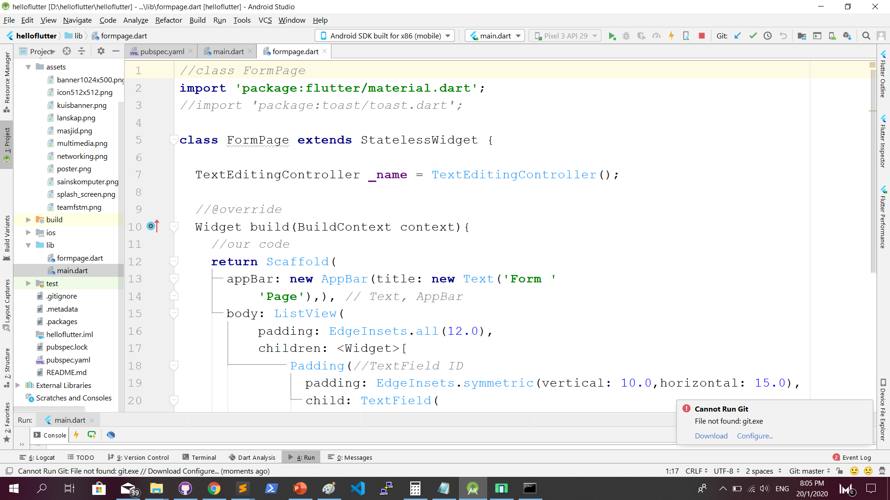
lib/formpage.dart

Slide 71
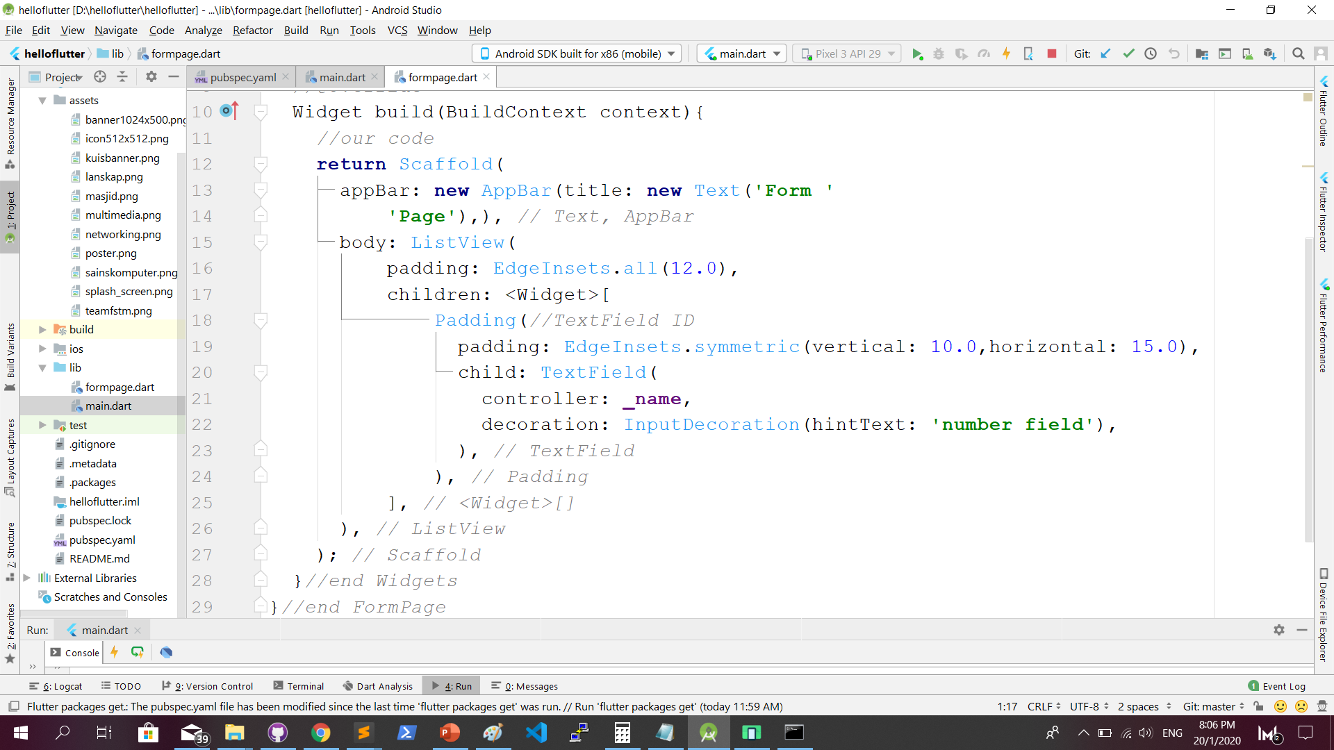
lib/formpage.dart …cont

Slide 72
PARAMETER PASSING
main
formpage
Data ( name: Kerul,
number: 10 )
Data ( name: Kerul,
number: 10 )
Display
Name: Kerul
Number: 10

Slide 73
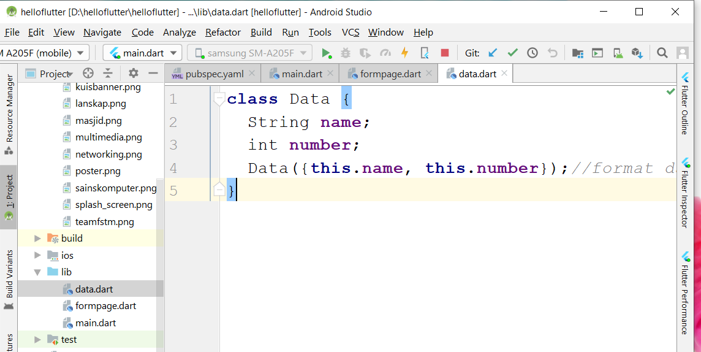
Define structure of Data in data.dart

Slide 74
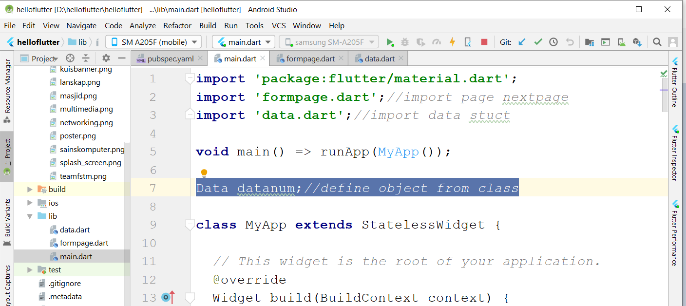
Define an object from Data in main.dart

Slide 75
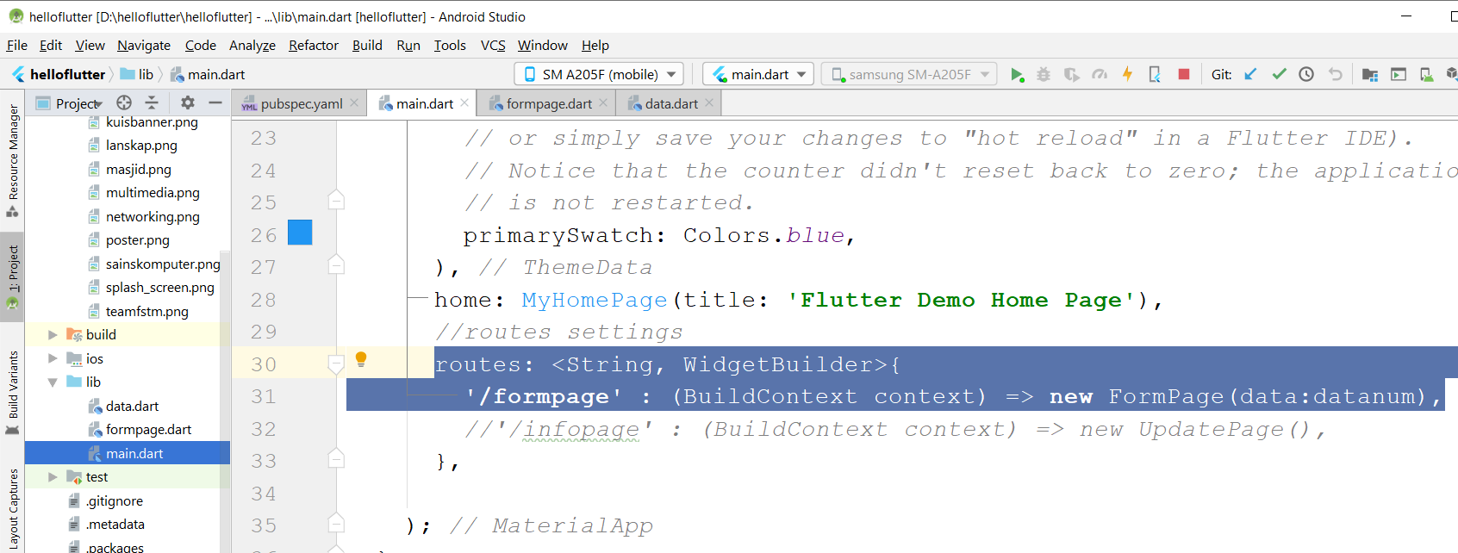
Define routes to a new page

Slide 76
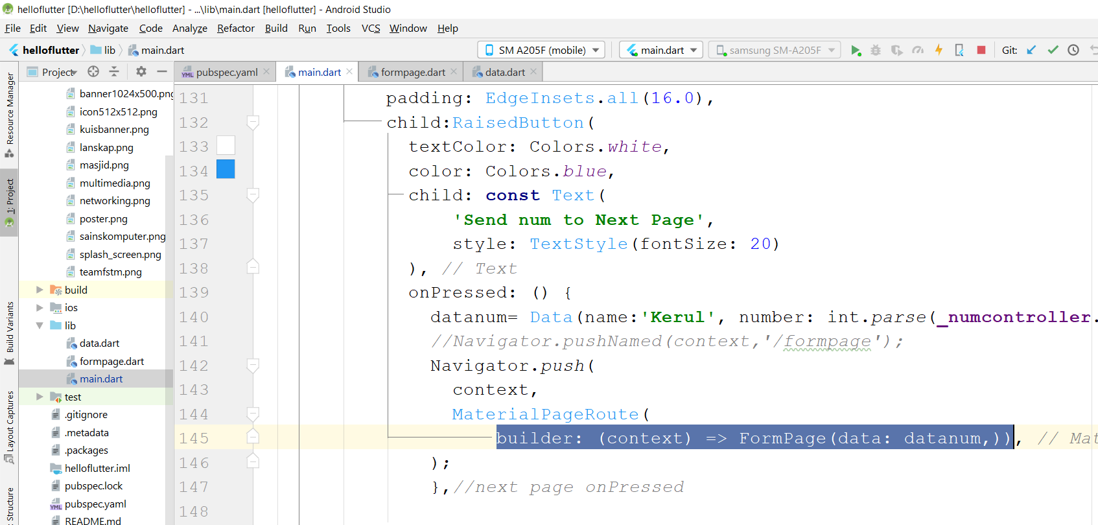
Invoke next page inside button onPressed()

Slide 77
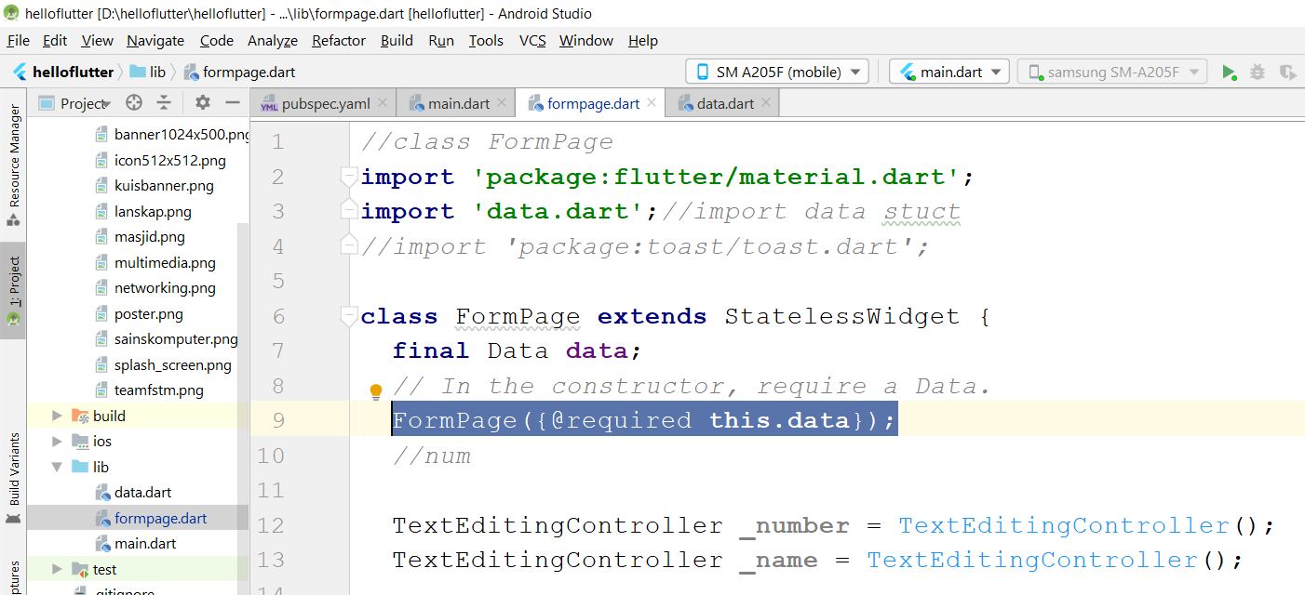
In the next page’s CONSTRUCTOR , @required the Data

Slide 78
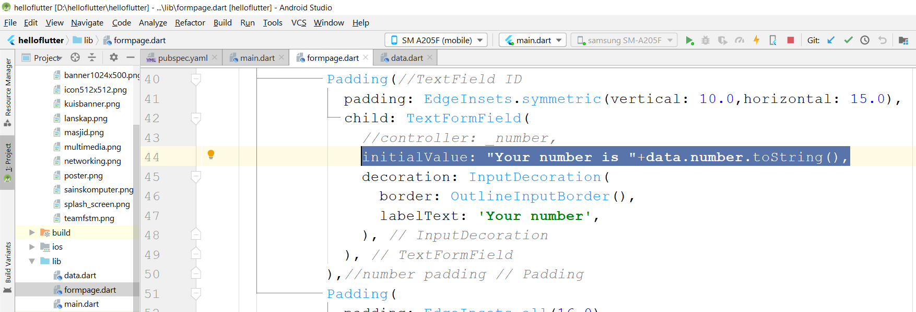
In the next page, set the initialValue of a TextFormField

Slide 79
GITHUB
Github.com/khirulnizam/helloflutter

Slide 80

T08 BMI (Apps flutter Ringkas)
Youtube tutorials
bit.ly/kerulflutter

Slide 81
GITHUB
A straight away Flutter body-mass index apps
github.com/khirulnizam/flutter_bmi

Slide 82
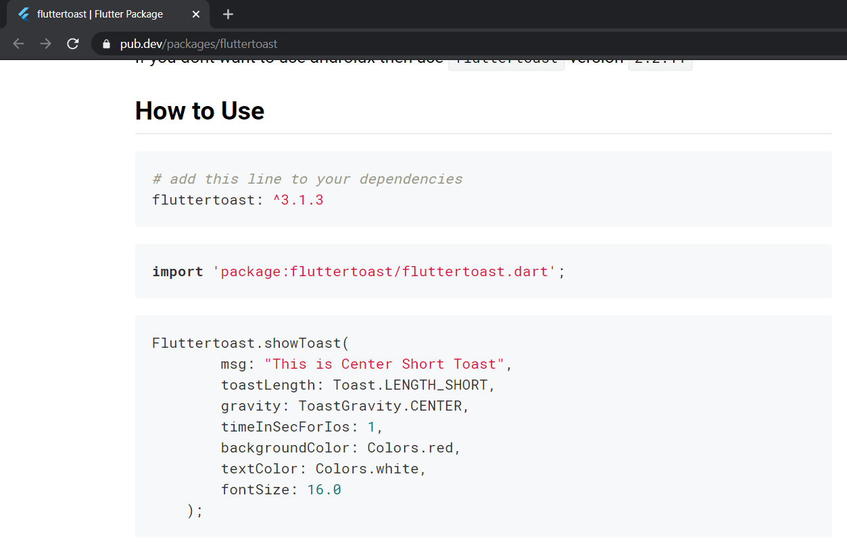
FlutterToast

Slide 83
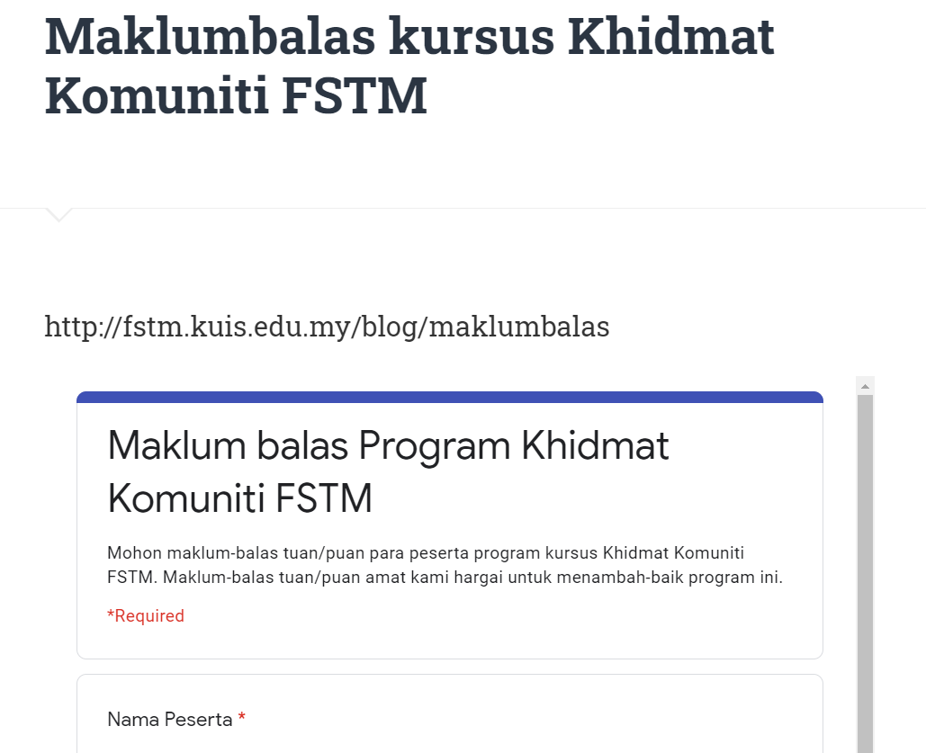
Provide your gmail at http://fstm.kuis.edu.my/blog/maklumbalas/

Slide 84
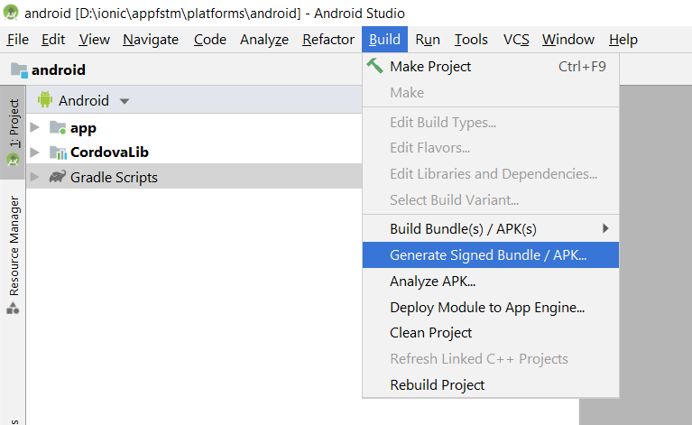
Using Android Studio to generate Sign APK

Slide 85
T09 Tambah Plug-ins (Toast)
Youtube tutorials
bit.ly/kerulflutter

Slide 86
GITHUB
A straight away Flutter body-mass index apps
github.com/khirulnizam/flutter_bmi

Slide 87
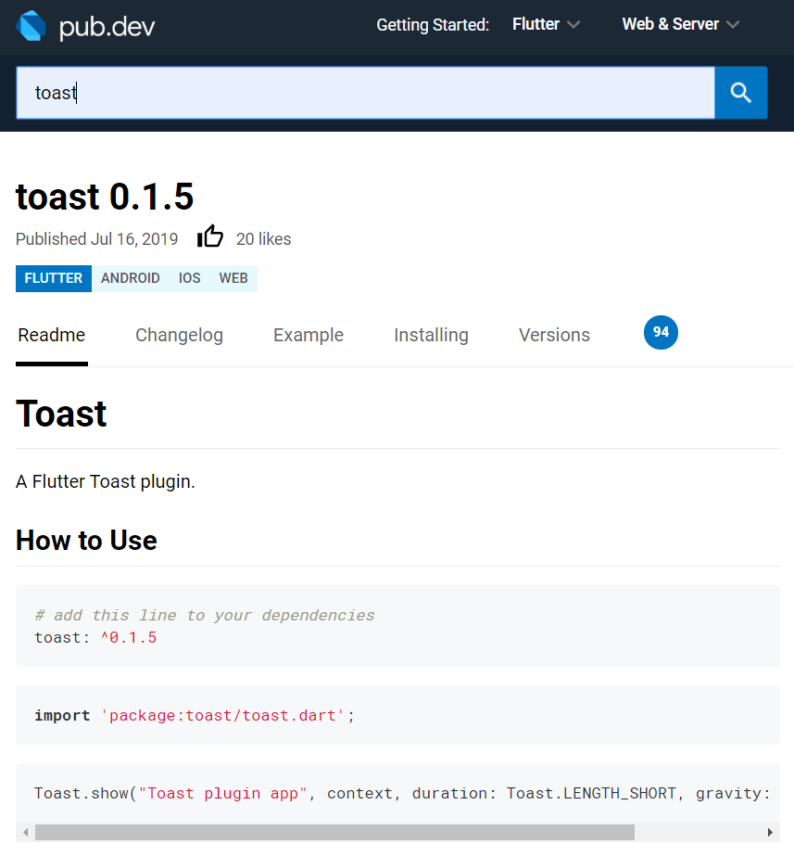
Toast plugins
https://pub.dev/packages/toast
pubspec.yaml
toast: ^0.1.5
main.dart
import 'package:toast/toast.dart';
Toast.show("Message", context, duration: Toast.LENGTH_LONG, gravity: Toast.BOTTOM );

Slide 88
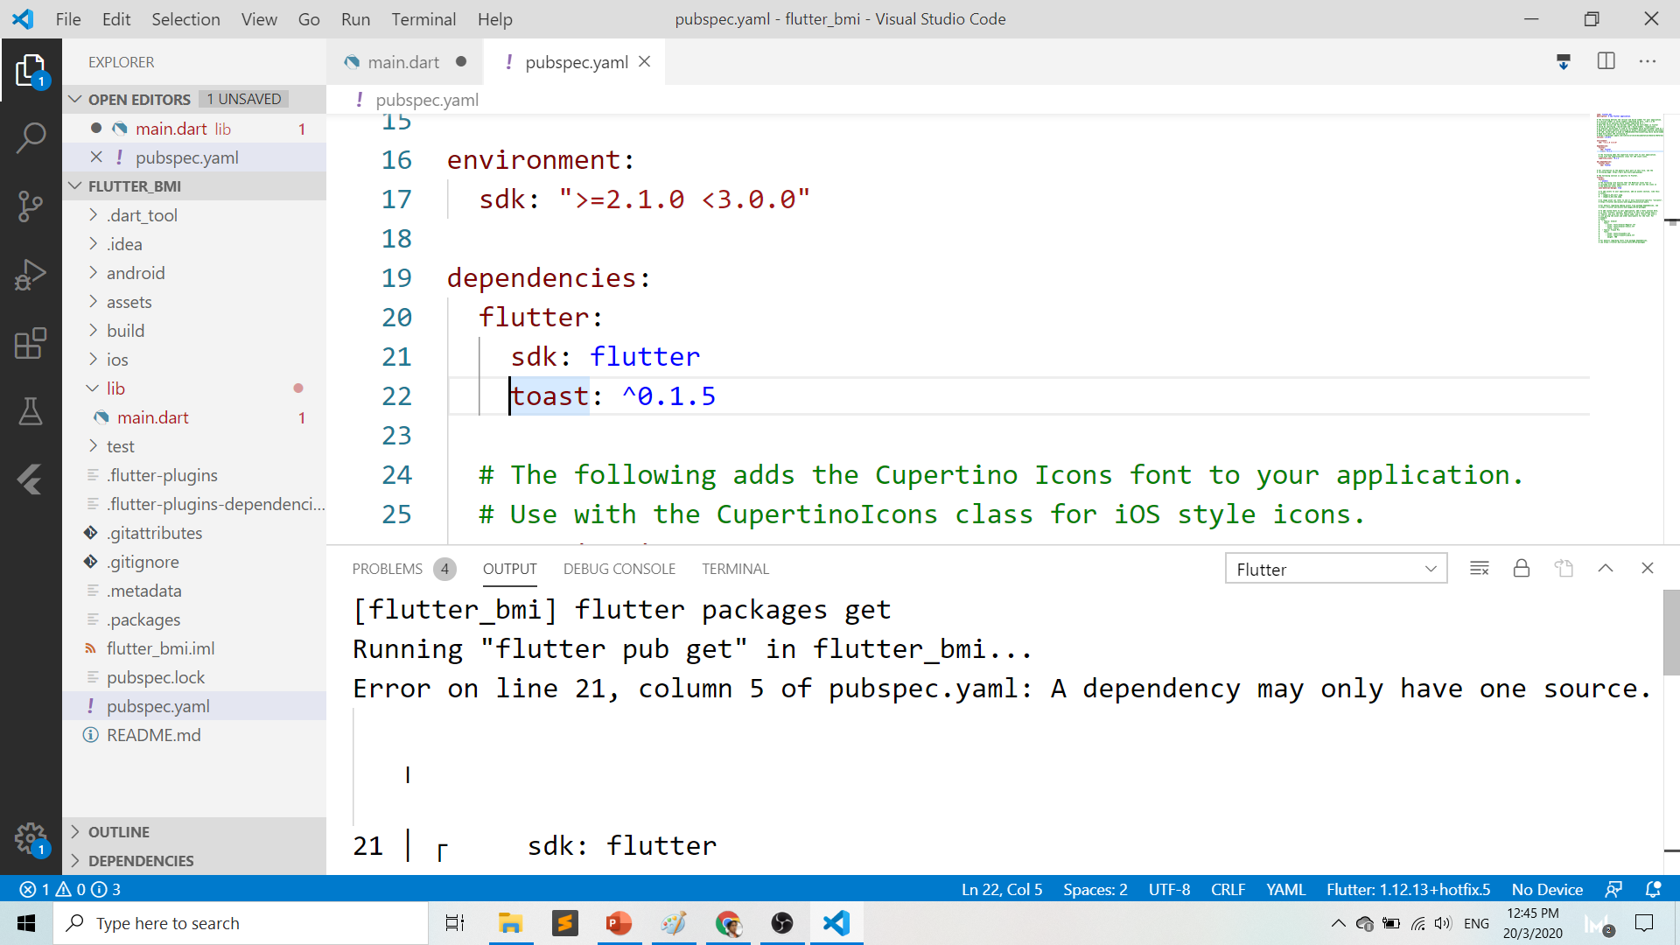

Slide 89
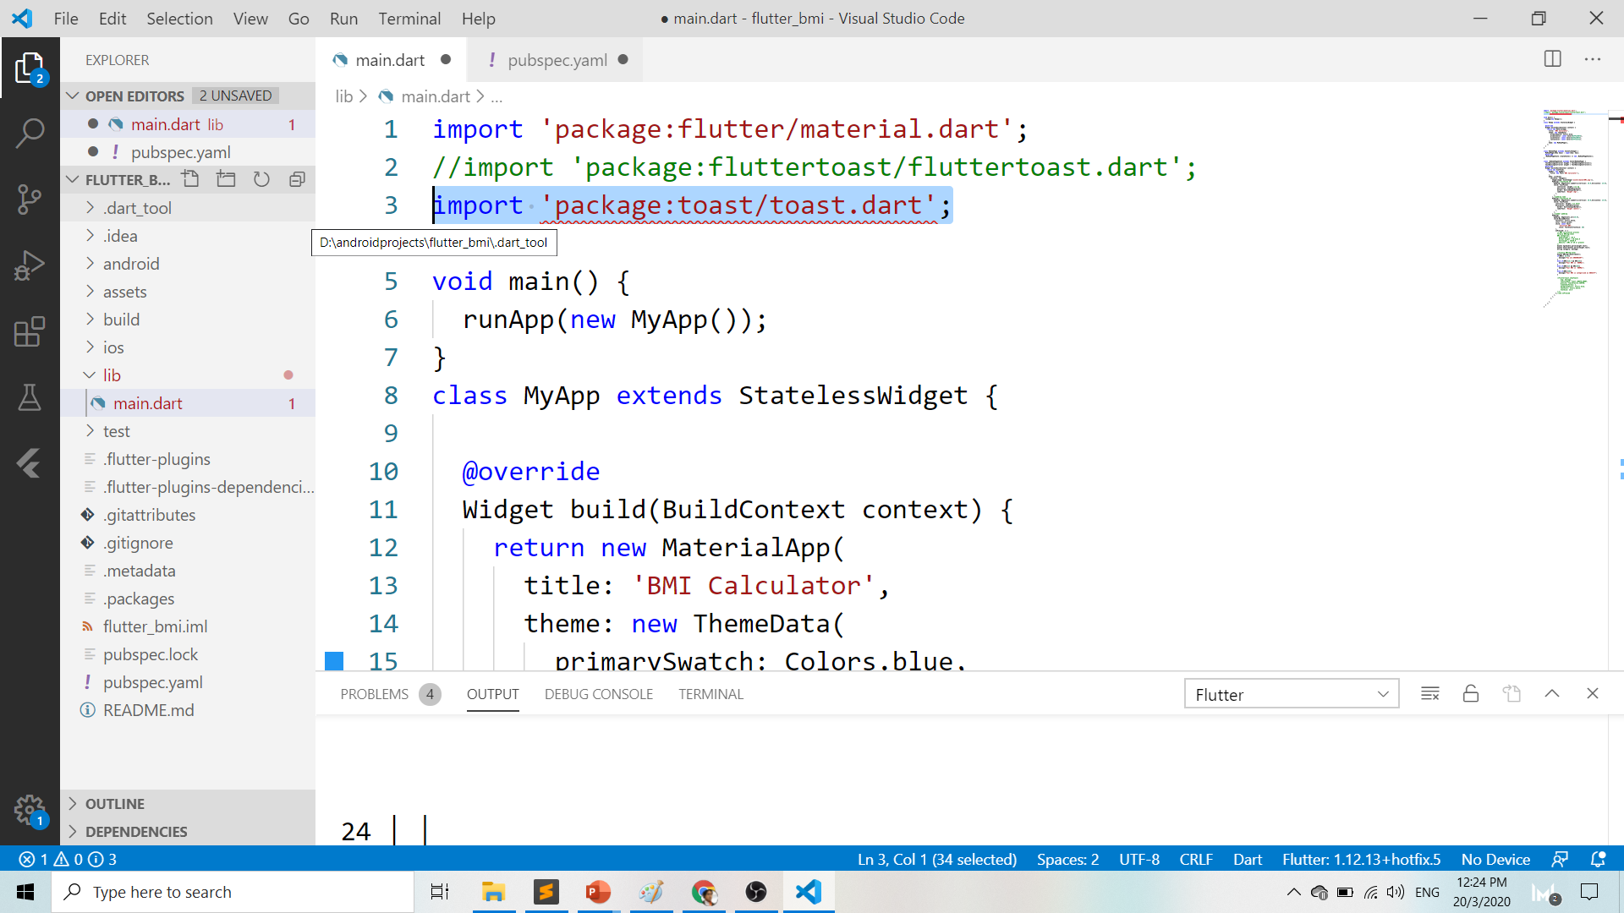

Slide 90
What do you need?
To run install Flutter:
Flutter SDK
Flutter Doctor
Android SDK
To develop:
Android Studio OR
VSCode
Emulator
Or actual device

Slide 91
Android/sdk/emulator location

Slide 92
Emulator –avd NAME_OF_AVD
Inside folder android/sdk/emulator
emulator -list-avds
emulator -avd NAME_AVD

Slide 93
T10 Debug apps on Android Phone (Uji-lari pada telefon pintar Android)
Youtube tutorials
bit.ly/kerulflutter

Slide 94
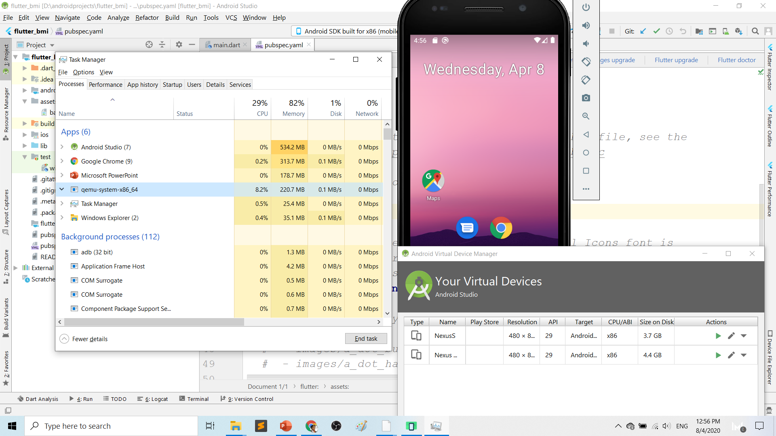
Play.google.com
What’s wrong with Android Emulator? RESOURCE-HUNGER

Slide 95
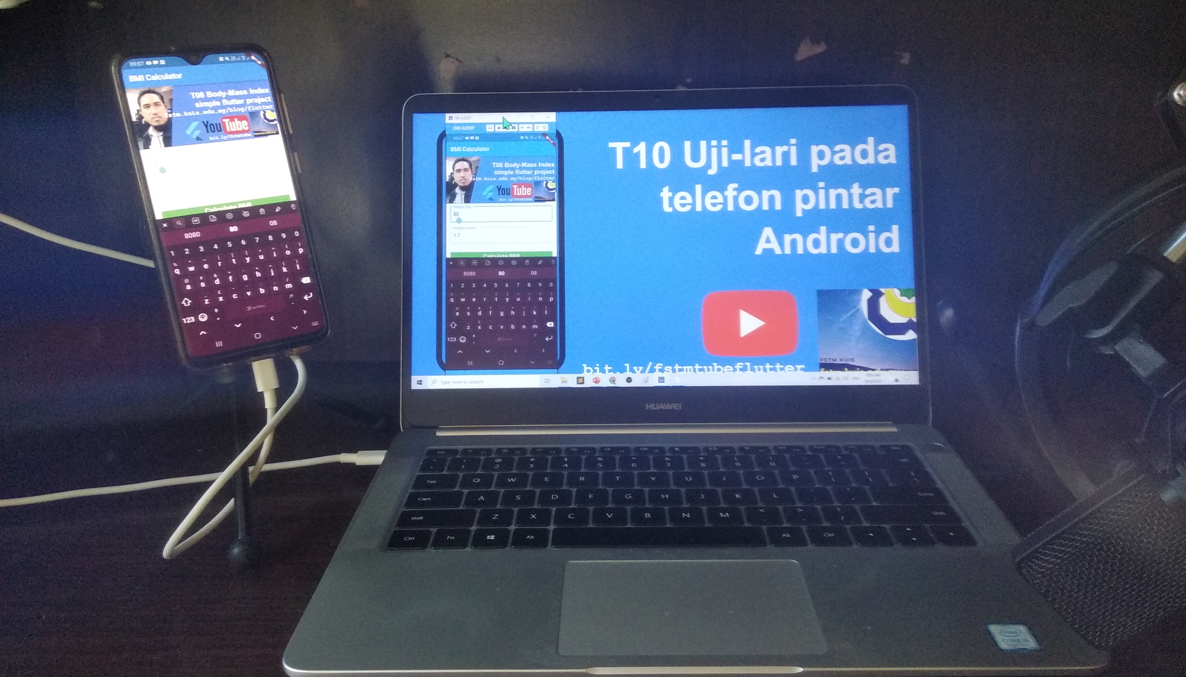
Requirements 1. USB debugging ON- phone 2. Connect USB Cable 3. Install ADB driver in PC

Slide 96
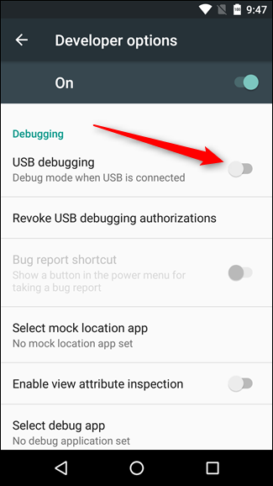
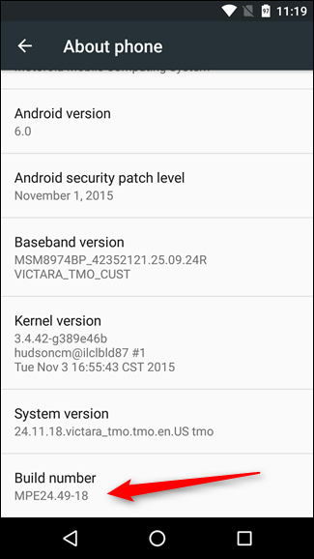
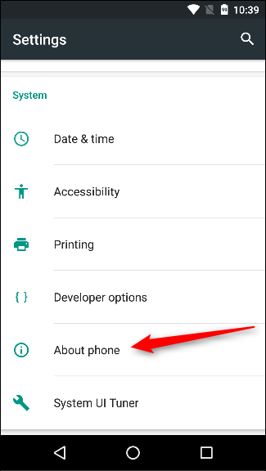
First time to on USB Debugging?
Developer options enable
Press 7X on build number
press 7x

Slide 97
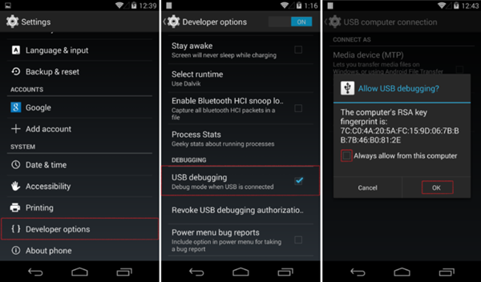
First time Allow USB debugging?

Slide 98
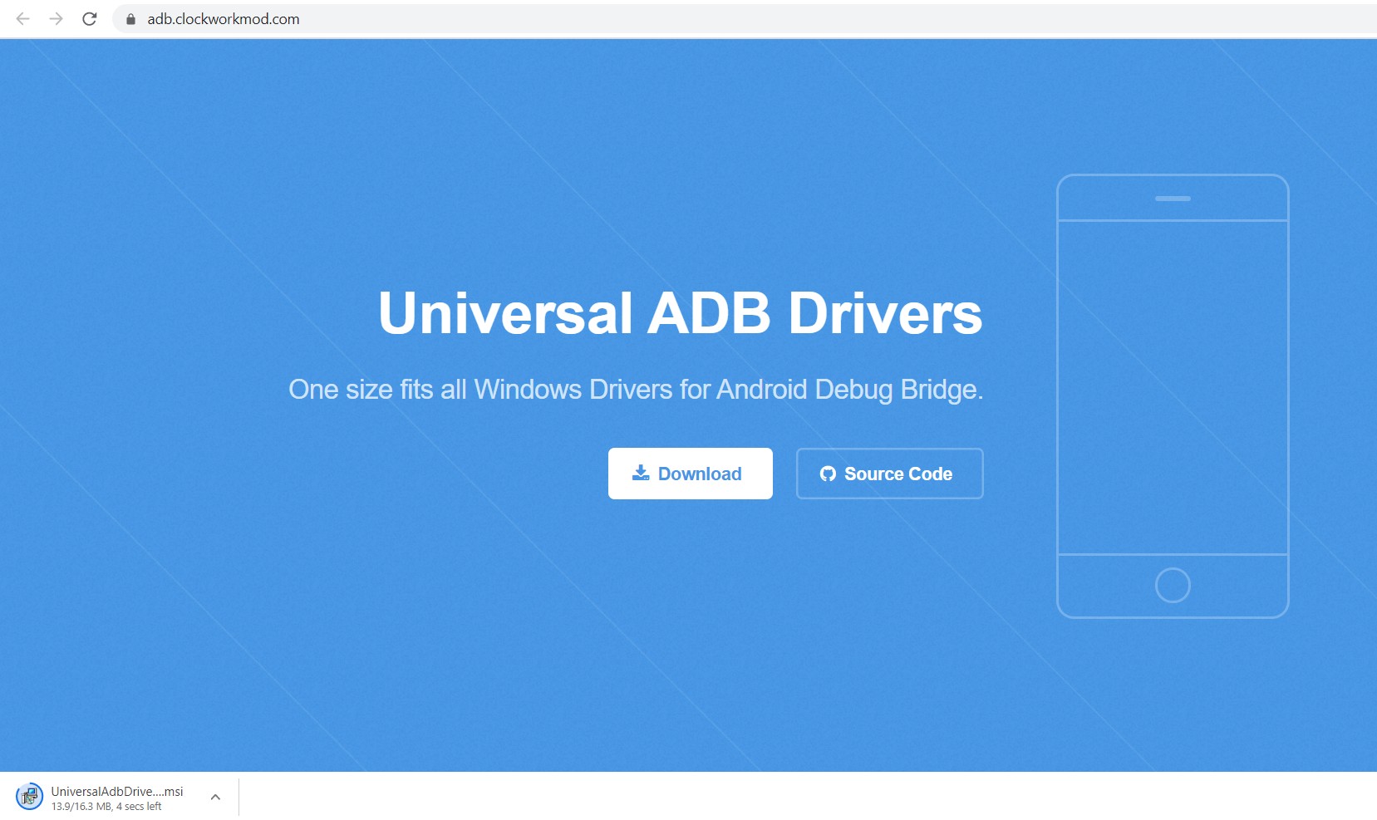
Play.google.com
Install universal debug driver
https://adb.clockworkmod.com/
Download & install universal debug

Slide 99


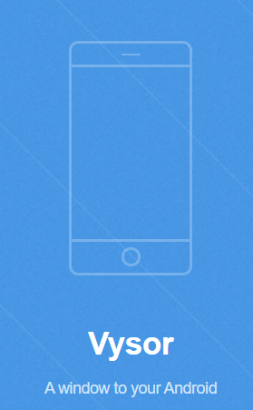


T06 Feed from Android
to OBS using Vysor
by enKerul, jsk fstm kuis
bit.ly/fstmobs

Slide 100

T11 Error Debugging
(Baiki ralat)
Youtube tutorials
bit.ly/kerulflutter

Slide 101
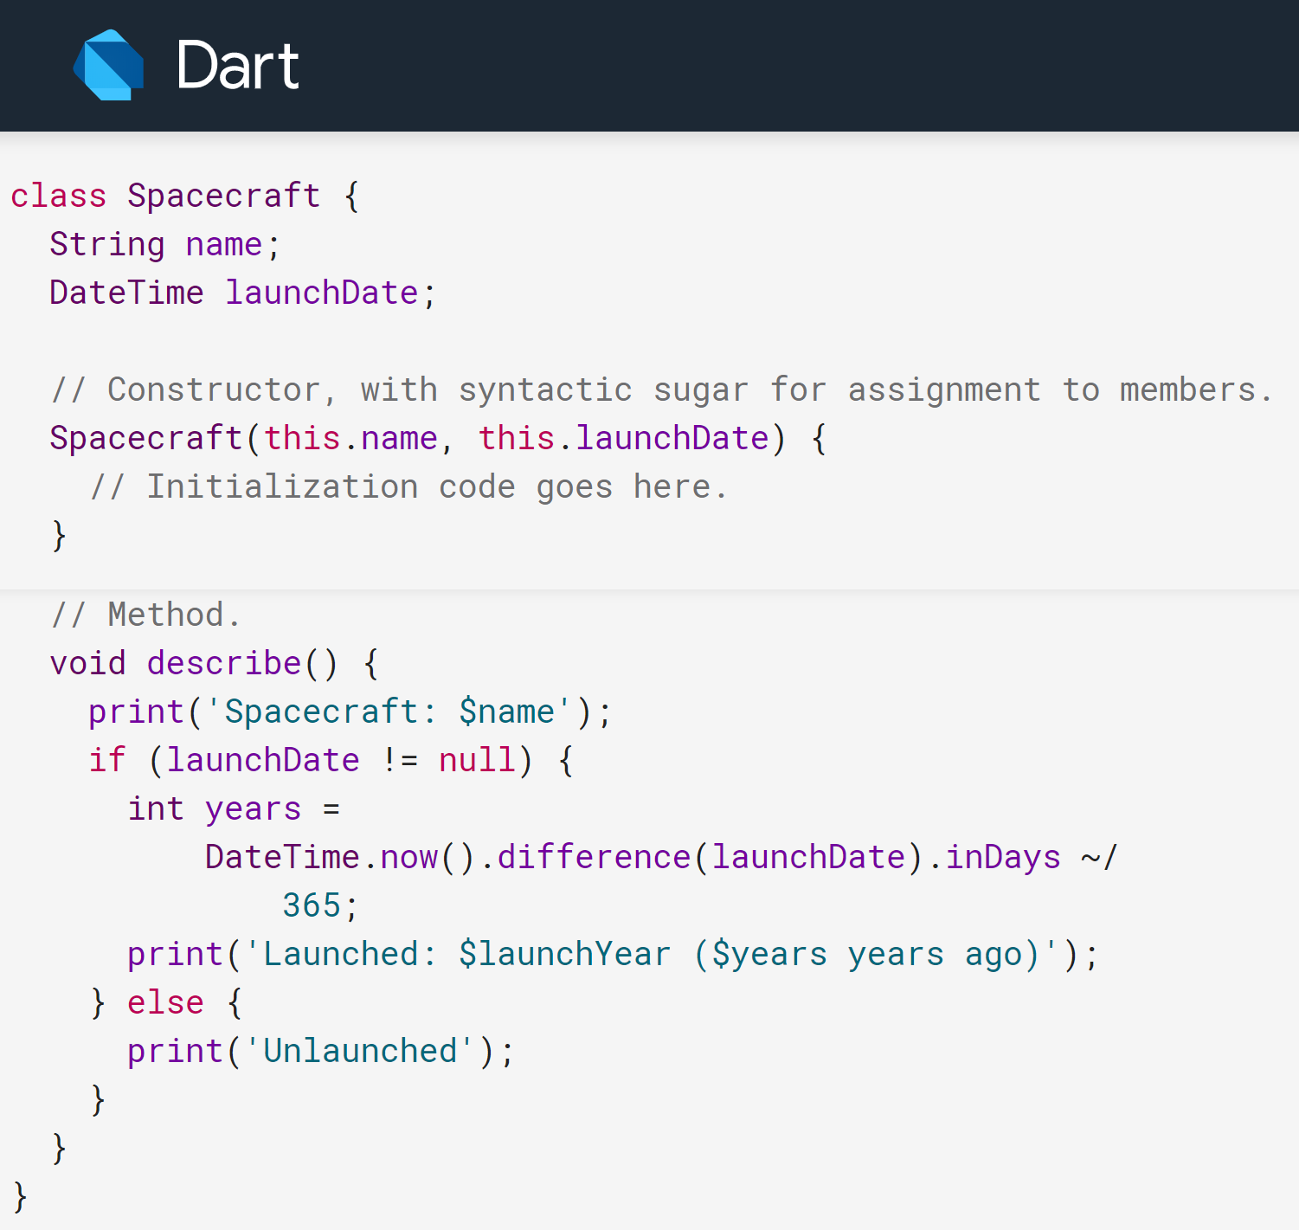
Brackets – missing pair
{…} – curly bracket
As in class or
method block

Slide 102
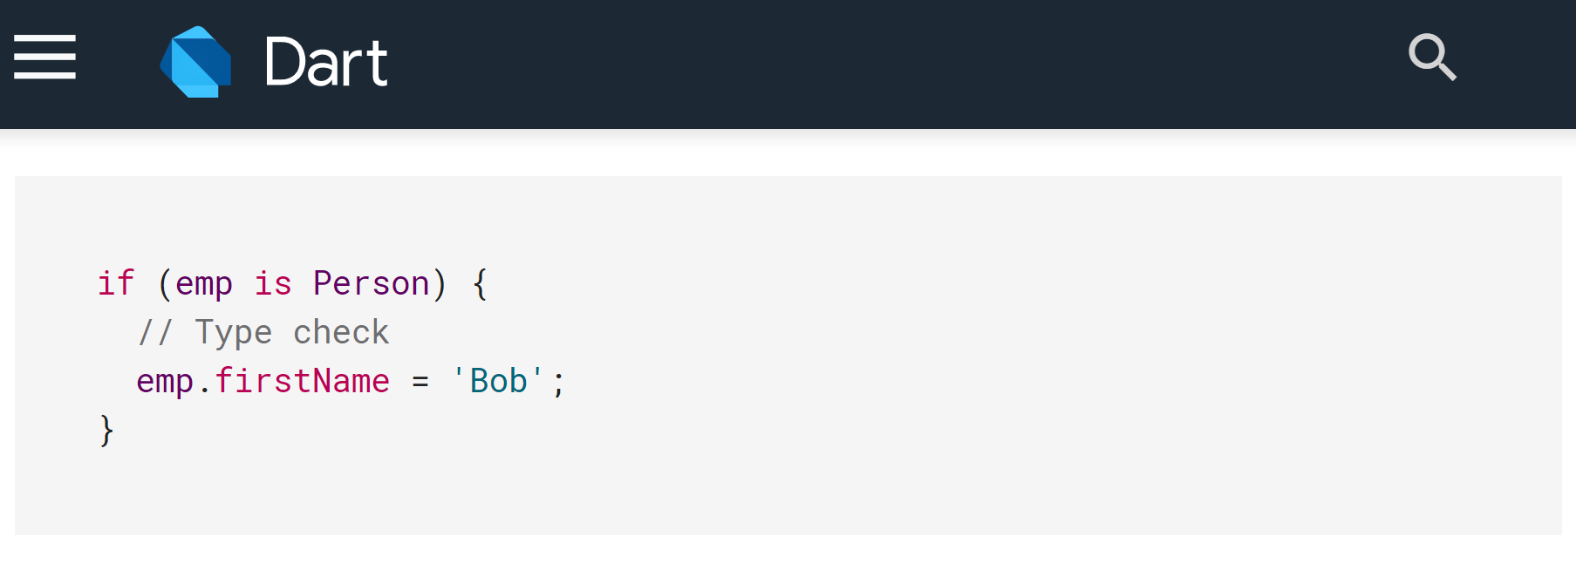
Brackets – missing pair
{…} – curly bracket
Or as in if/for/do/while/try/catch/async/await block

Slide 103

Brackets – missing pair
(…) – brackets
As in function’s arguments / parameters

Slide 104

Brackets – missing pair
(…) – brackets
Or as comparison / logical operations

Slide 105

Brackets – missing pair
[…] – square brackets
As in list/array
Example:

Slide 106

CodePen

Slide 107


Slide 108
The tricky part
Dart has so much brackets especially interface with child and children
Takes time to master the pattern
Luckily automatic comment on closing brackets are provided (in Android Studio).
VSCode also available for auto-commenting (get the latest Flutter). Great!
So good practice always comment your end block/bracket .

Slide 109


Slide 110


Slide 111



Casting - String to number
double kg=double.parse(weight.text);
double meter=height.text as double;
String category, message;
//formula BMI=kg/(m*m)
double BMI=kg/(meter*meter);
double kg=weight.text;
double meter=height.text;

Slide 112

Screen Overflowed
If you see the black-yellow stripe on your apps, do not fret.
Bottom overflowed caused by un-responsive screen.
Might as well wrap your UI component in a container.
Example: ListView

Slide 113


Slide 114

T12 Codelabs from Google
Youtube tutorials
bit.ly/kerulflutter

Slide 115

Play.google.com
Codelab
https://codelabs.developers.google.com/

Slide 116

https://codelabs.developers.google.com/codelabs/first-flutter-app-pt1/

Slide 117

T13 Online database (serverless)
Youtube tutorials
bit.ly/kerulflutter

Slide 118

Serverless option using Firebase
Serverless computing is a method of providing backend services on an as-used basis
A Serverless provider allows users to write and deploy code without the hassle of worrying about the underlying infrastructure
Lower costs - server allocation often result in the user paying for unused space or idle CPU time
Scalable - the serverless vendor handles all of the scaling on demand
Simplified backend code - developers can create simple functions t
Quicker turnaround - serverless architecture can significantly cut time to market hat independently perform a single purpose

Slide 119

Play.google.com
JSON format example applied in Firebase

Slide 120

JSON Concept
JSON: JavaScript Object Notation.
JSON is a lightweight data-interchange format
JSON format is text only, it can easily be sent to and from a server.

Slide 125

Play.google.com
Register for a developer ID
USD25 for life.
Another consideration: you need to pay through Google Wallet, using a credit card. https://play.google.com/apps/publish/

Slide 126
Graphic Materials
high-res icon. (size 512px x 512px)
Featured graphic. (size 1024px x 500px)
at least 2 non-Android TV screenshots. (2 screenshot images. Min length for any side: 320px)

Slide 127

Graphic materials & signed APK

Slide 128

Create Application

Slide 129


Slide 130

App Description

Slide 131

Upload graphic Assets

Slide 132

App Category

Slide 133

Upload APK

Slide 134

Upload APK

Slide 135

Content Rating

Slide 136

Pricing

Slide 137
GITHUB
Github.com/khirulnizam/helloflutter

Slide 138


